Slide 1
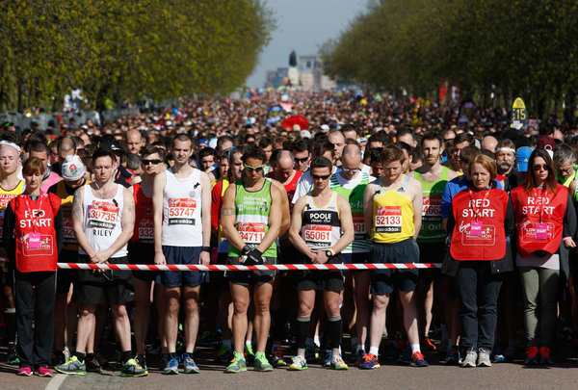
2015 GSPIA Amazing Analytics Race
Wednesday Training Camp
Sera Linardi
Assistant Professor of Economics

Slide 2
8:30am Getting ready: Your To-Do List
Introductions
Gabriel Gerner (IT) and TAs Scott McAllister and Shuning Tong (top 3 finishers in last year’s Amazing Race). Introduce yourself to 2 new people around you.
Register: find your name, cross it out, get nametags + breakfast
Get Stata if you haven’t already.
Get online if you haven’t already.
Go to http://www.linardi.gspia.pitt.edu/?page_id=564. The SCHEDULE of the day is online for you to check at any time.
Create a folder in your computer for all your files for math camp. Download Sampler, Slides, and the four .csv files into that folder
Open STATA, go to File, Change Working directory to your math camp folder.
Click on the Baseline math survey and try it. Use the ID # from your name tag.
We will start lecture at 9am.
Notes:
using the command: insheet using Cars.csv

Slide 3
Welcome
Your instructor:
Sera Linardi (linardi@pitt.edu)
PhD in Social Science, 2010, California Institute of Technology
Was a computer scientist at Adobe (working on PDF files)
I usually teach in the Fall: Micro I, Quant II, Game theory/Behavioral Economics
I research motivation to help others and ‘wisdom of the crowds’.
Sampler contains faculty research / classes that directly or indirectly utilize quantitative methods

Slide 4
What this workshop is and is NOT
What are we doing today? We are beginning your GSPIA journey with the end in mind: a career solving real world problems
First, let’s define what this workshop will NOT do:
Guarantee you an A in Quant I or Micro or any quant class
Make you a math whiz
Explain any mathematical concept in depth
What this workshop aim to do:
Connect quant methods to the real world. Begin to demystify math for those who fear it.
Provide you with a hands-on experience of how quant methods can give you an additional edge in tackling policy questions
Give a 1000 feet view of the classes, faculty members, and research opportunities that relates to quantitative methods

Slide 5
Schedule and people you will meet today
9 Linear equations (Exercise 1)
10:30 Matt von Boecklin, MPIA’13, Monitoring and Evaluation Manager, Liberia
11 Non-linear equation, derivatives (Exercise 2)
12:30 lunch
1:30 Intro to STATA (Exercise 3)
2:45 Michael Lewin, Lecturer (Econ Pub Affairs) & Jeremy Weber, Assistant Professor of Economics (Quant I)
3:30 Teams for Amazing Analytics Race (Group exercise)

Slide 6
And.. what is GSPIA’s
Amazing Analytics Race ?
At the end of today, you will be randomly split into pairs for tomorrow.
Your mission will be explained tomorrow morning at 9am where you will solve a puzzle using real world data, the quantitative methods you learn today, and lots of creativity.
You will be given your first clue at 9:15am and you will have 3 hours to accomplish your mission by interlocking a series of 10 clues.
What’s at stake: 1st place team = a $200 Bookstore gift certificate. 2nd place team = $100. 3rd place = $50.
After teams are formed today, we will brief you on the rules of the race, and your team will get to practice working together.

Slide 7
How today’s training camp works
Data - Lecture (<1hr)– Exercise (10-15 mins) – Review the exercise (5-10 mins)
You have the slides in your computer, so you can always go back / make notes, etc.
Ask questions! There is no dumb question, this is a refresher workshop so forgetting basic stuff is totally okay. In completing exercise feel free to ask your neighbors/TAs/instructor for help.
Please don’t browse the internet/ phone for unrelated stuff. If you are waiting for others to finish, see if anyone needs help. Check on your two new neighbors. Try new things in STATA.

Slide 8
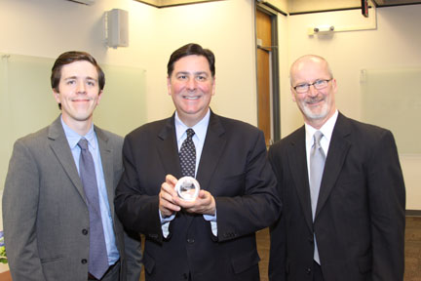
Imagine you are an advisor to the mayor of Pittsburgh
Peduto, GSPIA’11
He is wondering whether approving 10 new businesses on a strip of a crowded highway: businesses bring job worsens congestion
What you have to help you advise him:
  Data on travel time on several highways given number of cars (Cars.dta)
  Data on number of cars given number of businesses along the highway (Business.dta)
  Public opinion expert’s estimation that praise = business^2/2, and complaints = traffic wait time.
Notes:
Hourly average for cars and travel time.

Slide 9
Breaking down the question into mathematical concepts
how long does it take to travel the highway? (random variable)
how does the # of cars affect travel time? (correlation, linear regression, slope)
can adoption of a different traffic system reduce congestion? (simultaneous equations)
how does the # of businesses affect # of cars?(nonlinear equations)
what is the optimal # of business to have? (optimization)

Slide 10

1. random variable
How long does it take to travel through the highway?

Slide 11
Random variable
How long does it take to travel 20 miles on a city highway at 8am in the morning? Hands = 20 mins, 30 mins, 40 mins
Different day, same highway, same hour in day = different travel time.
Statistics is learning to get the information out of this uncertainty.
‘Time needed to travel’ is a random variable = the value is subject to variation due to chance.
Is what is written on this board ALL possible travel time for the 15 mile highway above? No. That would be the population. This is a sample. We usually only observe a sample of realizations of the random variable of interest.
Mean? Note also that if I had asked a different group of people, I would have written different numbers on the board, and therefore get a different mean.

Slide 12
Looking at data
Suppose cars.csv contains travel time and # of cars on various Pittsburgh highways
How do you load cars.csv into STATA so you can look at it?
We’ll do it 2 ways today, using the “Data Editor” and using the “insheet” command.
In general we’ll use STATA in two ways today, first using the drop down menu, and then using code.
Loading with Data Editor. Open cars.csv in Excel. Highlight, copy. Open data editor. Click on first cell and paste. Treat first row as variable name.
Note that the STATA you will learn today is just quick and dirty. You will learn how to use it properly in Quant I (with Jeremy) and Quant II (with me).

Slide 13
Histogram
Traveltime
Mode, median, mean?
Boxplot
hist traveltime
graph box traveltime
Graphics → Histogram ->Variable: traveltime
Notes:
Min (excluding outliers), lower quartile (25% data less than this value), median, upper quartile, max, outliers.

Slide 14
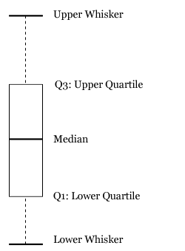
Showing distribution of data: boxplot
The whiskers can mean many things, so we won’t focus on it here.

Slide 15
Average travel time for that strip of highway is 26.7 minutes. However, the mayor is interested in congestion, so you are also interested in the # of cars on the highway.

Slide 16
# of cars on the highway
Histogram
Boxplot
Hmm.. does this help you understand traffic congestion?

Slide 17
2. correlation, linear regression, slope / rate / derivative
how does the # of cars affect travel time?

Slide 18
Relationship between two random variables correlation between cars and travel time
If we can describe this relationship with an equation, we can tell how travel time is affected by cars more generally.
scatter traveltime cars
Graphics → Twoway ->Create->Y variable: traveltime, X variable: cars

Slide 19
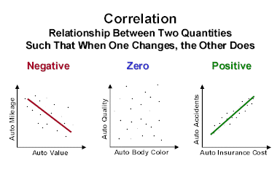
Scatterplot shows correlation between two variables.
To find the relationship, we can try to fit a line across this scatterplot that is the closest possible to ALL the points. This is a regression line.

Slide 20
Regression
reg traveltime cars
------------------------------------------------------------------------------
traveltime | Coef. Std. Err. t P>|t| [95% Conf. Interval]
-------------+----------------------------------------------------------------
cars | .0311483 .0004892 63.67 0.000 .0301888 .0321078
_cons | 14.7139 .2201573 66.83 0.000 14.28208 15.14571
-----------------------------------------------------------------------------
Statistics→ Linear model ->Linear Regression ->Dependent variable: traveltime,
Independent variable: cars
traveltime = 14.7 + 0.03*cars What does it mean?

Slide 21
Interpretation
traveltime = 14.7 + 0.03*cars
What does it mean?
When there’s 0 cars, it takes 14.7 minutes to travel? (Intercept)
With every additional cars, it takes another 0.03 minutes to travel. (Slope)
Or: change in travel time = 0.03 change in # of cars
It doesn’t matter how many cars are already on the highway.
We also say:
derivative of travel time with respect to cars=0.03
Or: d traveltime / d cars = 0.03
(Now you know the many ways to refer to this rate of change.)

Slide 22
Drawing a linear function
Linear function: Y=a+bX
Travel time = a+b cars
With a straight line, an increase
in X increases Y by the same
amount regardless of what X
is currently at.
30
Drawing the graph: traveltime = 14.7 + 0.03*cars
Where does the line hit 0? 14.7 This is a (intercept)
When cars increase by 1, travel time increase by 0.03 minutes. This is b (slope).
When drawing with slopes that are small it helps to use larger increases in x (e.g when cars increase by 1000, travel time increases by 0.03*1000 = 30 minutes)

Slide 23
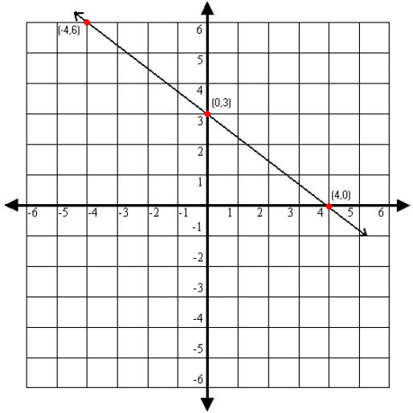
Looking at a graph and identifying the linear equation
Suppose this is a graph of your patience (y) as a function of traffic jams (x). What is the function?
Let y=a+bx
Step 1: Identify the vertical intercept
(0,3) a=3
Step 2: Identify the horizontal intercept
(4,0)
b = rise/run = 3/-4
Function is y=3-3x/4

Slide 24
Inverting a linear function
traveltime = 14.7 + 0.03*cars
If it takes you 20 minutes to travel, how many cars are on a freeway?

Slide 25
Inverting a linear function
You know travel time as a function of cars
traveltime = 14.7 + 0.03*cars
You want cars as a function of travel time:
Traveltime- 14.7 = 0.03*cars
Cars = (Traveltime- 14.7) / 0.03
Cars = Traveltime/0.03- 14.7/0.03
Cars = 33.3*Traveltime - 490
Now, it’s easier to answer this question:
If it takes you 20 minutes to travel, how many cars are on a freeway?
Cars = 33.3*20 - 490 =176
(BTW: what is the intercept and slope of this inverted function?
Intercept = -490 Slope 33.3
What is dCars / dTraveltime ? 33.3 )

Slide 26
Digression: when will you have to invert linear functions?
Quite often actually. For example in economics.
Here is a demand function
Qd = 100 - 2P
It is natural to draw this with Qd in the Y axis and P in the X axis (with 100 as the intercept and a -2 slope).
But the convention is to draw it with P in the Y axis – price as a function of quantity. So you have to invert it.
Here is the inverted demand function
  2P = 100 - Qd
P = 50-Qd/2
Now you can draw the demand function.

Slide 27
How many additional businesses should be allowed along a busy highway to maximize citizens satisfaction?
Breaking down the question into mathematical concepts
how long does it take to travel the highway? (random variable) On average 26.7 minutes.
how does the # of cars affect travel time? (correlation, linear regression, slope) Travel time = 14.7+0.03 cars
can adoption of a different traffic system reduce congestion? (simultaneous equations)
how does the # of businesses affect # of cars?(nonlinear equations)
what is the optimal # of business to have? (optimization, derivatives, chain rule)

Slide 28
3. comparing two highways: should you adopt another traffic system?
(simultaneous equations, or, systems of equations)

Slide 29
Previously you learned that for Pittsburgh highways, traveltime = 14.7 + 0.03*cars.
A colleague suggested that in anticipation of congestion from the new businesses, you should consider a traffic system that has been adopted by Cleveland to reduce travelling time. There, traveltime = 8.7 + 0.05 cars.
Should you do that? What is the maximum # of cars such that travelling with the Cleveland system is faster than the Pittsburgh system?

Slide 30
Pittsburgh: Traveltime = 14.7 + 0.03 cars
Cleveland : Traveltime = 8.7 + 0.05 cars
The question asks for what is cars such that traveltime is equal to each other.
Several methods:
You can solve a linear systems by:
Graphing: draw both lines and see where they meet.
Substitution:
Traveltime = 8.7 + 0.05 cars
14.7 + 0.03 cars = 8.7 + 0.05 cars
6 = 0.02 cars.
Cars = 300
Given that mean # of cars on Pittsburgh highways is 385 (see data), the Cleveland system would actually cause more congestion.
Travel
time
cars

Slide 31
(A) 2x – 3y= 2
x + 2y= 8
Nature of Solutions to Systems
of Equations
y
5
(4, 2)
y
(B) 4x + 6y= 12
2x + 3y= –6
5
x
–5
5
x
–5
–5
5
Lines intersect at one point only.
Exactly one solution: x = 4, y = 2
y
–5
5
Lines are parallel
No solution.
(C) 2x – 3y = –6
–x + ³/₂ y = 3
5
x
–
5
–5
Lines coincide. Infinitely many solutions.
8-1-85

Slide 32
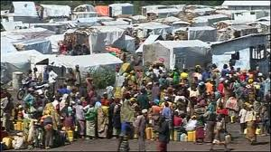
Other applications: making inferences
  An NGO is running a refugee camp. Cost per day is on average $1.50 for children and $4.00 for adults. On a certain day, 2200 people were living in the camp and $5050 was spent that day. How many children and how many adults are in the camp?
number of adults: a
number of children: c
total number: a + c = 2200
total cost: 4a + 1.5c = 5050
a = 2200 – c
4(2200 – c) + 1.5c = 5050
8800 – 4c + 1.5c = 5050
8800 – 2.5c = 5050
–2.5c = –3750
c = 1500
a = 2200 – (1500) = 700
There were 1500 children and 700 adults.

Slide 33
You will also see a lot of simultaneous equations in economics, so let’s preview them.
Price
P*
Earlier in linear functions
20
E.g Qd = 160-8P
To draw, invert it:
8P = 160-Qd
P = 20 – Qd/8
Vertical intercept = 20
To draw the horizontal intercept, set P to 0 and solve for Qd.
0=20-Qd/8
Qd=20*8=160
Note this is the same as the vertical intercept in the non-inverted function (160)
demand
quantity
Q*
160

Slide 34
Now: Two linear functions: for example: Supply-demand equilibrium in perfect competition
supply
Qd = 160-8P
Qs = 70+7P
P*
160-8P=70+7P
90 = 15P P=6
The intersection of the supply and demand curve (P*, Q*) represents the equilibrium.
Equilibrium price: price where there is the same number of people who wants to buy as there are people who wants to sell
demand
Q*
quantity

Slide 35
Exercise 1 10:15 am

Slide 36

Alumni chat:
Matt von Boecklin MPIA’13
More than Me Foundation, Liberia
  Monitoring and Evaluation Manager – May 2015 - Present
  Project: Get REAL (Rebuild Education for All Liberians), a developing joint effort with the Ministry of Education to improve primary schools throughout Liberia.
National Entrepreneurship Network (NEN), Bangalore, India
  Entrepreneur Support and Impact Assessment Fellow — May 2014 – 2015
  Project: Dream to Destination Entrepreneur Support Program, a year-long intervention focusing on improving fundability, scalability, and revenue growth for 100 women-owned Indian enterprises.
Vital Voices Global Partnership, Washington D.C.
  Program Evaluation Consultant — February - May 2014
  Data Analysis Coordinator — June 2013 - January 2014
  Project: Vital Voices Global Leadership Awards Program, an annual, weeklong event meant to enhance the credibility and visibility of extraordinary women leaders from around the world.

Slide 37
15 minutes break
When we return (11am) :
Review Exercise 1
Linear functions

Slide 38
Review Exercise 1
Questions?

Slide 39
How many additional businesses should be allowed along a busy highway to maximize citizens satisfaction?
Breaking down the question into mathematical concepts
how long does it take to travel the highway? (random variable) On average 26.7 minutes.
how does the # of cars affect travel time? (correlation, linear regression, slope) Travel time = 14.7+0.03 cars
can adoption of a different traffic system reduce congestion? (simultaneous equations) No.
how does the # of businesses affect # of cars?(nonlinear equations)
what is the optimal # of business to have? (optimization, derivatives)

Slide 40
4. Nonlinear function
We will now use our other data set, “business.csv”
This data set has # of businesses on a highway and the number of commuter cars associated with these businesses.
what would new businesses do to highway congestion?

Slide 41
clear (you must clear out the old data)
Load new Business.csv
Look in data editor
What relationship are we trying to figure out?

Slide 42
scatter commutecars business
Is this a linear function?
Will a straight line
give you the smallest error?

Slide 43
Nonlinear functions
Let’s find what our function resembles:
Quadratic function
Logarithmic function
Exponential function

Slide 44
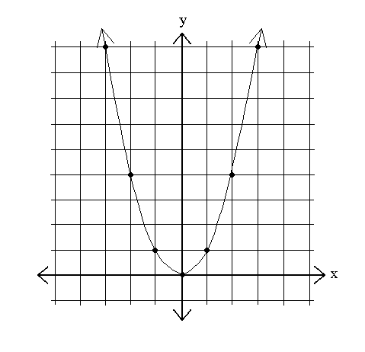
Quadratic function
Y=x²
x | Y
-3 | 9
-2 | 4
-1 | 1
0 | 0
1 | 1
2 | 4
3 | 9
Notice how Y changes as X change.
The slope is no longer the same (“not a constant”)
The change in Y is 1 as x goes from 0 to 1,
3 as x goes from 1 to 2,
5 as x goes from 2 to 3.

Slide 45
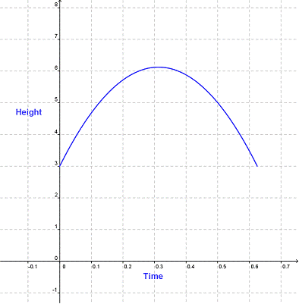
Other quadratic functions
y = ax² + bx + c
y = (ax + b)(cx + d)
y = a(x+b)² + c
Is a>0 or a<0 here?
Quadratic functions are one type of polynomial functions:

Slide 46
Working with polynomials more generally
Example:
Y=3x⁸ Q=.4P^{1/3} Generally: Y=mx^{c}
Identify: m constant, x variable, c exponent
Some special ones:
x¹ = x
x⁻¹ = 1/x x⁻² = 1/x²
x⁰ = 1
x^{1/2} = sqrt(x)
When there is no constant, the ”hidden” constant is 1.
E.g, when you see = x, think 1*x¹
When there is no variable, the ”hidden” variable has a power of 0.
  E.g, when you see = z, think z*x⁰

Slide 47
Derivatives: the “slope” of a polynomial
the power rule:
if y=mx^{c} , dy/dx= mcx^{c-1}
y=3x². constant=3, var =x, exponent=2.
dy/dx=3*2x⁽²⁻¹) =6x
y=x⁻¹. constant=1, var=x, exponent=-1.
dy/dx=1*-1x⁽⁻¹⁻¹⁾ = -1x⁻² = -1/x²
If you see things like this: y = ax⁵ + bx³ + cx – it’s just the same =mx^{c}
you can deal with the terms one at a time.
But you may need to simplify the equation first.
When will you use this in class? When you’re trying to figure out rate of change.

Slide 48
Quadratic function
Y=X²
dY/dX = 2X¹=2X
x | Y
-3 | 9
-2 | 4
-1 | 1
0 | 0
1 | 1
2 | 4
3 | 9
Earlier: the actual change in Y is 1 as X goes from 0 to 1, 3 as X goes from 1 to 2.
With the derivative the approximated change in Y is 0 as X goes from 0 to 1 (X=0, dx=1), 2 as X goes from 1 to 2, 4 as X goes from 2 to 3.
How would Y change if X goes from 5 to 5.2? This is asking for dY if X=5, dX=0.2
dY = 2X*dX =2*5*0.2 =2
To check, do 5.2² – 5² = 2.04 – pretty close
Notes:
27.04 - 25

Slide 49
Rules for simplifying polynomials
Product rules | x ^{n} · x ^{m} = x ^{n+m} | 2³ · 2⁴ = 2³⁺⁴ = 128
 | x ^{n} · b ^{n} = (x · b) ^{n} | 3² · 4² = (3·4)² = 144
Quotient rules | x ^{n} / x ^{m} = x ^{n-m} | 2⁵ / 2³ = 2⁵⁻³ = 4
 | x ^{n} / b ^{n} = (x / b) ^{n} | 4³ / 2³ = (4/2)³ = 8
Power rules | (x ^{n}) ^{m} = x ^{n·m} | (2³)² = 2^{3·2} = 64
When will you use this in class? When you’re working with utility functions.

Slide 50
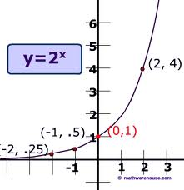
Exponential function
The growth of a terrorist cell:
At month 0 there’s 1 person 1
At month 1 this person recruited 2 people 2
At month 2 each persons recruited 2 people 4
What is the function that describe the growth?
f=2^{x} where x is time (month)
This is an exponential functions
Notice it “asymptotes” at the y axis.

Slide 51
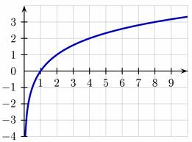
Logarithmic function
Time since the inception of the terrorist cell
If there is 1 member it must have just started t=0
If there are 2 members it must have been last month. t=1
If there are 32 members t =?
(5 months)
Equation: y=log₂x where x is # of members and y is months
"log_{a} x" means "to what power (exponent) must a be raised to get x?
This is the inverse
of the exponential function
Notice it “asymptotes” at the x axis.

Slide 52
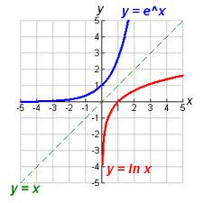
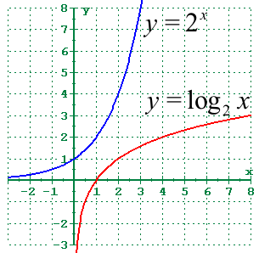
2^{x} and exp(x)
Logs and natural logs
Exp(x) = 2.72^{x}
This quantity is often used when quantities grow proportionally to it’s value. It is often seen in math, physics, and chemistry.
When will you use this? When you’re learning about logistic regressions.

Slide 53
Some rules for dealing with exp and logs
Log₂ 2 = 1 since 2^1 = 2
Log₂ 4= 2 since 2^2 = 4
Log 32 = Log 2*16 = Log 2 + Log 16
since 2¹ * 2⁴ = 2⁵=16
Log 1/16 = Log 1 - Log 16
since 2⁰ / 2⁴ = 2⁻⁴
ln e = 1. since e^1 = e
ln ab = ln a + ln b.
ln a / b = ln a - ln b.
ln a^{n} = n ln a.

Slide 54
Derivatives for logs and exp
y=a^{x} dy/dx=a^{x} ln a
y=e^{x} dy/dx=e^{x}
y=log a (x) dy/dx= 1/ (x ln a)
y=ln (x) dy/dx= 1/ x
Notes:
because ln (x) = log e (x) , and ln e=1

Slide 55
So back to your data:
Quadratic?
Exponential?
Logarithmic?
Indeed, cars = 130+290*ln(business)

Slide 56
5. what is the optimal # of business to have? (optimization, compound functions)

Slide 57
How do we optimize a function?
Suppose this is Y = 8X-.8X²
How can we find X where Y is at a maximum?
Find x where the slope of Y is 0

Slide 58
General Optimization
Recall power rule: if Y=mx^{c} , dY/dX= mcx^{c-1}
Supposed want to maximize a function:
Y = 8X-.8X²
First we have to take a derivative:
dY/dx = 8*1X¹⁻¹-.8*2X²⁻¹
= 8-1.6X
Then when we set it to 0, we can solve for X that maximizes the function
8-1.6X = 0
8 = 1.6X
X=5

Slide 59
X | Y
0 | 0
1 | 7.2
2 | 12.8
3 | 16.8
4 | 19.2
5 | 20
6 | 19.2
7 | 16.8
8 | 12.8
9 | 7.2
10 | 0
11 | -8.8
12 | -19.2
Y = 8X-0.8X²
dY/dX = 8 – 0.8*2*X = 8-1.6X

Slide 60
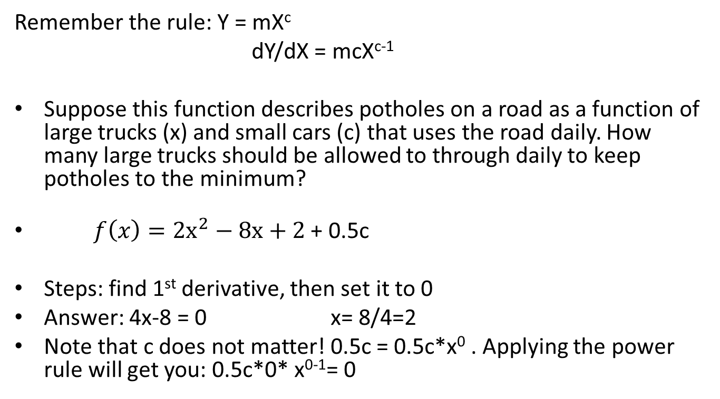
Another example
Remember the rule: Y = mX^{c}
dY/dX = mcX^{c-1}
Suppose this function describes potholes on a road as a function of large trucks (x) and small cars (c) that uses the road daily. How many large trucks should be allowed to through daily to keep potholes to the minimum?
$f\left(x\right)={2x}^{2}−8x+2$ + 0.5c
Steps: find 1st derivative, then set it to 0
Answer: 4x-8 = 0 x= 8/4=2
Note that c does not matter! 0.5c = 0.5c*x⁰ . Applying the power rule will get you: 0.5c*0* x⁰⁻¹= 0

Slide 61
How many businesses should be on the highway?
Let’s break this down:
How does business affect travel time?
  We know how cars affect travel time
  And we know how businesses affect cars.
Suppose his public opinion expert says:
complaints = travel time,
praise = # of business²/2
Then how can he maximize:
praise – complaints ?

Slide 62
You have cars and traveltime. You have business and cars. How do you combine them?
cars = 130+290*ln(business)
traveltime = 14.7 + 0.03*cars
traveltime = 14.7 + 0.03* (130+290*ln(business) )
traveltime = 18.6+8.7ln(business)
How does an additional business affect travel time?
dt/db = 8.7/business
If there’s 1 business on the highway, 1 extra business will add 8.7/1 = 8.7 minutes to traffic
If there are 100, 1 extra will add 8.7/100 = 0.087 minutes to traffic
How does a small business (treat this as db=0.5) affect travel time?
Change in t = (8.7 /business) change in b
If there’s 1 business on the highway, 0.5 extra business will add (8.7/1)*0.5 = 4.35 minutes to traffic

Slide 63
Now we are ready to use the info from the public opinions guy:
Praise = # of business²/2
Complaints = traveltime = 18.6+8.7ln(business)
We want to maximize: Benefit= Praise – Complaints
Benefit = business²/2 -18.6-8.7ln(business)
Take derivative:
d Benefit / d business = business – 8.7/business
Set to 0, we get:
0 = business – 8.7/business
8.7/business = business
8.7 = business²
Optimal number of business = sqrt(8.7) = 2.95 or 3 businesses

Slide 64
Exercise 2
12:30 lunch come back 1:30pm

Slide 65
1:30 Review Exercise 2
Any questions?

Slide 66
Writing and saving commands in STATA
In your classes (and in your job in the future) you will want more control over what you did to the data and replicability.
This is so that you can remember what you did and so that you and others can replicate your results.
This is harder to do with the menu bar.
  Go to Window, Do File Editor, and choose New Do-file Editor.
  This will open a new .do file.
  Write your commands in it.
  Highlight one of the commands and click the “Execute (do)” icon. It should run the command. You can also copy and paste directly to the command window.
  Save this file as MathCamp.do
  Continue adding commands into this file.

Slide 67
Loading and exploring
Clearing memory: clear
Loading .csv file: insheet using ‘Cars.csv’
See all variables: sum
String variables vs numeric variables

Slide 68
Relationship between variables
Pwcorr

Slide 69
Sorting and Viewing Data
Sort
Only sort in ascending order
List
Show specific rows
gsort
Sort in both order
Ascending: gsort cars
Descending: gsort -cars
.
sort cars
. list in 1/5
+----------------------------------+
v1 cars travel~e highway
----------------------------------
1. 1153 0 18.31223 Roscoe
2. 1532 0 15.03788 Roscoe
3. 1321 0 15.07491 Roscoe
4. 170 0 18.04261 Robb
5. 822 0 12.8783 Jemison
+----------------------------------+
. list in -5/L
+----------------------------------+
v1 cars travel~e highway
----------------------------------
1670. 220 1170 57.35289 Robb
1671. 253 1190 45.25637 Robb
1672. 554 1210 55.85953 Clarion
1673. 1390 1220 54.14872 Roscoe
1674. 59 1230 47.82588 Roscoe
+----------------------------------+

Slide 70
Conditional statements
(if, and (&), or (|), ==, != )
sum traveltime if cars < 100
mean traveltime if cars > 150 & cars < 200
reg traveltime cars if highway !=“SqHill”
sum traveltime if highway ==“SqHill” | highway == “Clarion”
list traveltime if highway ==“SqHill” & cars > 400

Slide 71
Generating new variables
gen: simple transformations of other variables
  gen travelsq = traveltime^2
What if you mess up making a variable and want to recreate it? Eg. You want travelsq to be ½*traveltime^2
drop travelsq
  gen travelsq = (1/2)* traveltime^2
  Can combine gen with logical statements :
  gen toocrowded = (cars>400)
  Using your new variable:
  reg traveltime cars if toocrowded
  reg traveltime cars if !toocrowded
  reg traveltime toocrowded

Slide 72
Groups and group means
  tab highway
tab : tabulates (count the frequency of similar occurrence). eg.
  tab highway
egen create groups statistics, eg:
  egen timehighway=mean (traveltime), by(highway)
  tab timehighway
gen vs egen
They both create a new variable, but work differently

Slide 73
Graphing
Boxplot: graph box traveltime
Histogram: hist traveltime
Kernel density estimate: kdensity traveltime
Comparing: twoway (kdensity traveltime if cars>300) (kdensity traveltime if cars<300)
Now scatterplot is a relationship between two things. In our data we have cars on the highway and how long it takes to travel 15miles. You have to think hard about what relationships you want to examine.
Scatterplot: scatter traveltime cars
Comparing: twoway (scatter traveltime cars if cars>300) (scatter traveltime cars if cars<300)
Comparing: twoway (scatter traveltime cars) (scatter travelsq cars)
How to save your graphs?
File– Save As – (I usually do .pdf)
Or: Win users: right click and click Copy and then paste into your word doc.
Try it.

Slide 74
If have time:
A little bit on how random variable vary and on statistical significance
Else:
Exercise 3

Slide 75
How much does your travel time vary?
If you have an important meeting, how much time will you give yourself? Why? What is the probability you will be late given the time you picked?
To know that we need to understand how travel time varies. Let’s do this systematically.
Standard deviation (σ): measuring variation in a random variable
1. Calculate mean (μ)
2. Compute the difference of each data point from the mean, and square the result of each
3. Compute the average of these values, and take the square root.
Bigger standard deviation, more uncertainty.

Slide 76
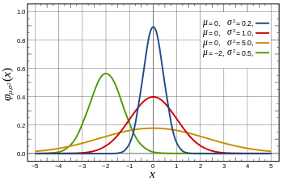
Kernel density estimates:
Which distribution would make you feel most uncertain about your travel time?

Slide 77
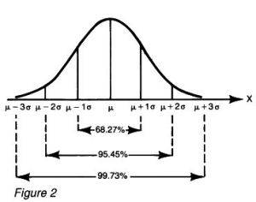
Normal distribution
When the histogram looks like a bell curve the random variable is normally distributed.
Then everything becomes simpler (due to the symmetry and more in Quant I):
e.g the probability of getting values > any threshold can be computed.
Prob of being late when you give yourself μ minutes is (100%) / 2 = 50%
Prob of being late when you give yourself μ+σ minutes is (100%-68%) / 2 = 16%
Prob of being late when you give yourself μ-σ minutes is 68%+16% = 84%
Prob of being late when you give yourself μ+2σ minutes is (100%-95.45%) / 2 = 2.275%
Statistics is a study of random variable, its distribution, its relationship with other random variables, and what we can infer about populations from sample.

Slide 78
Statistical significance in regressions
When traffic is very sparse( cars<50), how does an additional car affect travel time?
reg traveltime cars if cars<50
------------------------------------------------------------------------------
traveltime | Coef. Std. Err. t P>|t| [95% Conf. Interval]
-------------+----------------------------------------------------------------
cars | .0078617 .0180347 0.44 0.664 -.0281668 .0438901
_cons | 15.7433 .4229513 37.22 0.000 14.89835 16.58824
------------------------------------------------------------------------------
Compare the ratio between coefficient and standard error on cars for this regressions and the earlier one
reg traveltime cars
------------------------------------------------------------------------------
traveltime | Coef. Std. Err. t P>|t| [95% Conf. Interval]
-------------+----------------------------------------------------------------
cars | .0311483 .0004892 63.67 0.000 .0301888 .0321078
_cons | 14.7139 .2201573 66.83 0.000 14.28208 15.14571
-----------------------------------------------------------------------------

Slide 79
When we compare the ratio between coefficient and standard error on cars for the 1st and 2nd regression we get:
0.00786/0.018 = 0.44 .031148 /.000489 = 63.67
This says that if μ=0, the first coeff on car is the blue arrow and second coeff on car is red.
Or: effect of # car on travel time is statistically indistinguishable
From 0 when traffic is very sparse.
The pvalue summarizes the statistical significance.
Pval = prob that we get this coefficient when the actual effect of
cars on travel time is actually zero.
For the first one, it is very like (66.4%)
For the second regression, it is highly unlikely (0.00%)
0

Slide 80
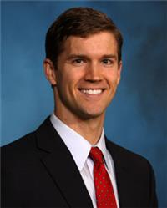

2:45pm Faculty Chat
Jeremy Weber,
Assistant Professor of Economics
Will teach Intro to Quant
Previously Research Economist
at the U.S. Department of Agriculture
Michael Lewin,
Lecturer
Will be teaching Econ for Public Affairs
Previously Senior Economist
at the World Bank
Break 3:00 to chat informally with faculty, we start lecture at 3:30

Slide 81
Review Exercise 3
Any questions?
On to teams.
We will call out your names. When you meet up you are going to move to sit together.
In the last exercise you will work together in your new team.

Slide 82
On to the Race!
Here are the teams
Come up and meet your teammate as your name is called.
Show Race Packet Materials.
Tomorrow: you will absolutely need your computer.
You will be coding and thinking and racing from room to room, so make sure you are comfortable.
There will be 9 clues. Solving each clue under three tries will earn your team 1 point. The team with the highest number of points wins the race. Ties are broken by how quickly you complete the race.
There will be Roadblocks. In Roadblocks each person in the team must solve a puzzle individually. The point will only be given if both team members succesfully solve their puzzle.

Slide 83
How to win?
Review all the material tonight with your teammate and decide on how you want to handle roadblocks and other scenarios. The math will be simple but will require creative applications.
Stata commands: You MUST get familiar with all the commands we did today.
When getting your answers checked you can send just one person so one of you can continue working.
Tomorrow: you can setup starting from 8:30am. We will distribute materials for the race at 9am.
On to work with your teammate!

Slide 84

Training done!

