Slide 1
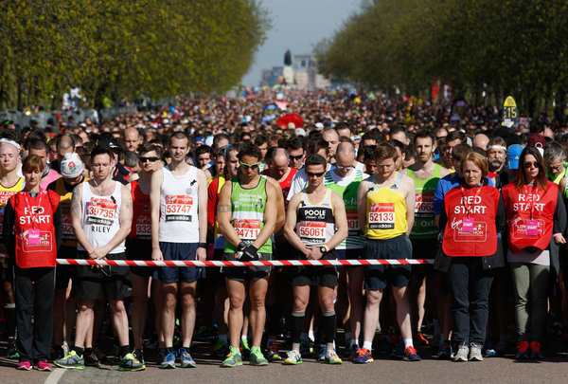
2017 GSPIA Amazing Analytics Race
Wednesday Training Camp
Sera Linardi
Assistant Professor of Economics

Slide 2
9am Getting ready: Your To-Do List
Introductions
Tekky Bambang and Quintin Lemom (IT) and TAs Alicia Houser and Meghan Yost.
Introduce yourself to 2 new people around you.
Register and find your ID number on your name tag
Get STATA if you haven’t already.
Get online if you haven’t already. If you are unable to get online, request paper copies of exercises from the TAs and move closer to the front to see the slides.
Go to http://www.linardi.gspia.pitt.edu/?page_id=564. The SCHEDULE of the day is online for you to check at any time.
Create a folder in your computer for all your files for math camp. Download all materials for Wednesday into that folder
Open STATA, go to File, Change Working directory to your math camp folder.
Click on the Baseline math survey and try it. Use the ID # from your name tag.
We will start lecture as soon as everyone is set up (between 9:15-9:30 am).
Notes:
using the command: insheet using Cars.csv

Slide 3
Welcome
Your instructor:
Sera Linardi (linardi@pitt.edu)
PhD in Social Science, California Institute of Technology
Behavioral economist; I use experiments to study the psychology behind the motivation to help others (e.g in the context of interethnic relationships in Afghanistan, lending in Islamic banking) and behind the use of social services.
I teach Quant II in the Fall and Game theory/Behavioral Economics in the Spring. I’m also teaching data visualization with R in Spring.

Slide 4


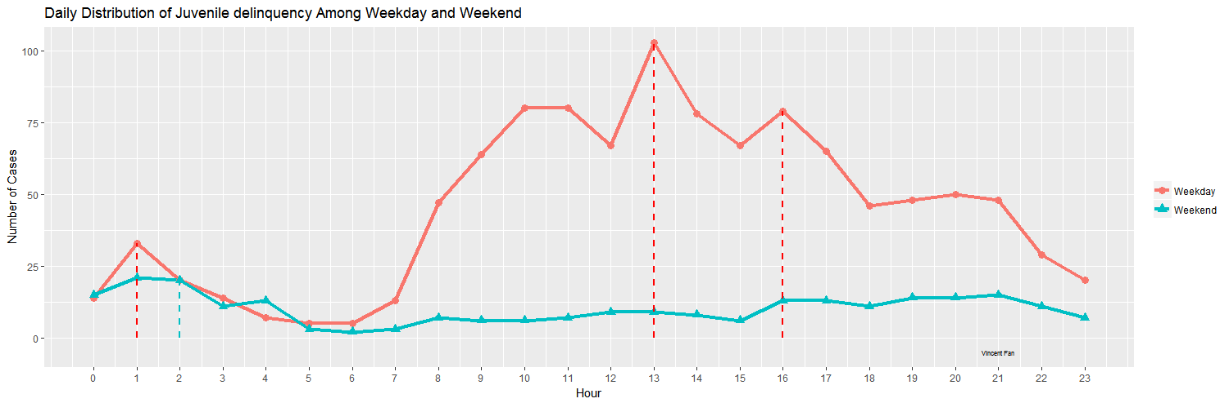
R Data Visualization
Capstone
WPRDC
Daily Distribution of Juvenile Delinquency Among Weekdays and Weekends

Slide 5
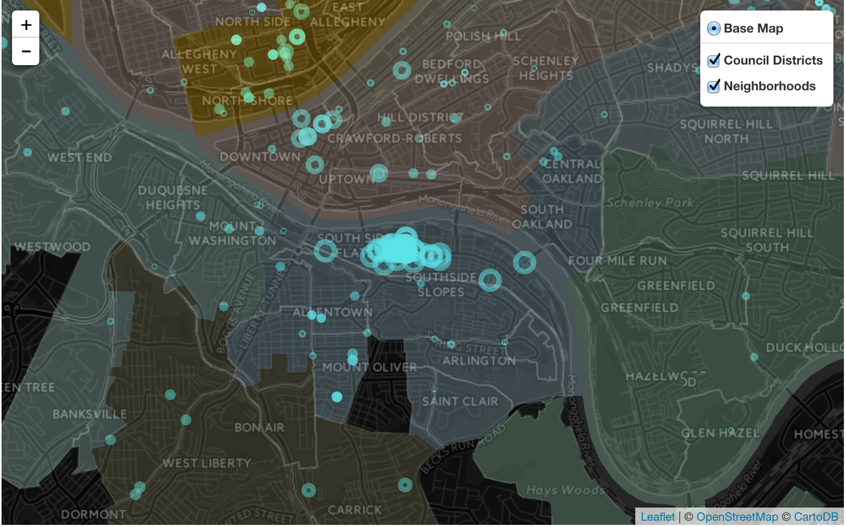
R Data Visualization Capstone
Our Map
GIS for Arrest Data https://visiuchen.shinyapps.io/PITTSBURGH-CRIME-MAP/

Slide 6
What this workshop is and is NOT
What are we doing today? We are beginning your GSPIA journey with the end in mind: a career solving real world problems
First, let’s define what this workshop will NOT do:
Guarantee you an A in Quant I or Micro or any quant class
Make you a math whiz
Explain any mathematical concept in depth
What this workshop aims to do:
Connect quant methods to the real world.
Give you a previous of ALL the math you will see during your time here. You will most likely not encounter any math that you have not seen today.
Provide a quick-and-dirty, hands-on experience of how quant methods give you an additional edge in tackling policy questions

Slide 7
Schedule and people you will meet today
9:00 registration, materials & setup, baseline quiz.
9:15-10:20 Lecture 1: Linear functions, Exercise 1
10:20-10:30 Meet your quant professors
10:30-10:45 Break
10:45-12:00 Lecture 2: Nonlinear functions and derivatives, Exercise 2
12:00-1:00 Break
1:00-2:30pm Amazing Analytics Race teams (TAs), Lecture 3: Intro to Stats, Exercise 3
2:30-2:45pm Break
2:45pm-3:30pm Team exercise

Slide 8
And.. what is GSPIA’s
Amazing Analytics Race ?
At the end of today, you will be randomly split into pairs for tomorrow.
Your mission will be explained tomorrow: you will have 3 hours to solve a puzzle by interlocking a series of 10 clues with your partner.
You will use real world data, the quantitative methods you learn today, and lots of creativity.
What’s at stake: 1st place team = a $200 Bookstore gift certificate. 2nd place team = $100. 3rd place = $50.
After teams are formed today, we will brief you on the rules of the race, and your team will get to practice working together.

Slide 9
How today’s training camp works
Data - Lecture (<1hr)– Exercise (10 mins) – Review the exercise (5-10 mins)
You have the slides on your computer, so you can always go back / make notes, etc.
Ask questions! There is no dumb question, this is a refresher workshop so forgetting basic stuff is totally okay. In completing exercise feel free to ask your neighbors/TAs/instructor for help.
Please don’t browse the internet/ phone for unrelated stuff. If you are waiting for others to finish, see if anyone near you needs help, or try new things with STATA.

Slide 10
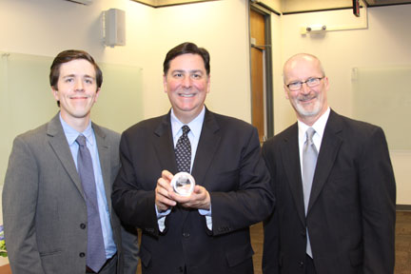
Imagine you are an advisor to the mayor of Pittsburgh
Peduto, GSPIA’11
He is wondering whether or not to approve 10 new businesses on a strip of a crowded highway: businesses bring jobs but worsen congestion
What you have to help you advise him:
  Data on travel time on several highways given the number of cars on the highway (Cars.csv)
  Data on number of cars given number of businesses along the highway (Business.csv)
  Public opinion expert’s estimated relationship between business development, traffic congestion and support for city government
Notes:
Hourly average for cars and travel time.

Slide 11
Breaking down the question into mathematical concepts
how long does it take to travel the highway? (random variable)
how does the # (number) of cars affect travel time? (correlation, linear regression, slope)
can adoption of a different traffic system reduce congestion? (simultaneous equations)
how does the # of businesses affect # of cars?(nonlinear equations)
what is the optimal # of business to have? (optimization)

Slide 12

1. random variable
How long does it take to travel through the highway?

Slide 13
Random variable
How long does it take to travel 20 miles on a city highway at 8am in the morning? Hands = 20 mins, 30 mins, 40 mins
Different day, same highway, same hour in day = different travel time.
Statistics is learning to get the information out of this uncertainty.
‘Time needed to travel’ is a random variable = the value is subject to variation due to chance.
Is what is written on this board ALL the possible travel times for 20 miles? No. That would be the population. This is a sample. We usually only observe a sample of realizations of the random variable of interest.

Slide 14
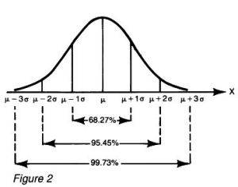
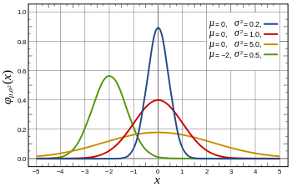
Distribution: what the population looks like
Suppose this is all possible values of travel time and how likely you are to get any of them. Suppose the mean is 20 minutes, and the “standard deviation” is 5 minutes. Bigger standard deviation = more variability.
This is a normal distribution: notice its symmetric about its mean.
Things follow some simple rules with the normal distribution:
Prob of being late when you give yourself 20 minutes is (100%) / 2 = 50%
Prob of being late when you give yourself 20+5 minutes is (100%-68%) / 2 = 16%
Prob of being late when you give yourself 20-5 minutes is 68%+16% = 84%
Prob of being late when you give yourself 20+2*5 minutes is (100%-95.45%) / 2 = 2.275%
Statistics is a study of random variable, its distribution, its relationship with other random variables, and what we can infer about populations from sample.

Slide 15
Looking at data
Suppose cars.csv contains a random sample of travel time and # of cars on Pittsburgh highways.
How do you load cars.csv into STATA so you can look at it?
Loading with Data Editor. Open cars.csv in Excel. Highlight, copy. Open data editor. Click on first cell and paste. Treat first row as variable name.
(In general we’ll use STATA in two ways today, first using the drop down menu, and then using code. )
Note that the STATA and statistics you will learn today is just quick and dirty. You will learn how to use it properly in Quant I (with Jeremy) and Quant II (with me).

Slide 16
Histogram
Travel time
Mode, median, mean?
Boxplot
Upper quartile
Median
Lower quartile
hist traveltime (not normal, but we’ll treat it as such today)
graph box traveltime
Graphics → Histogram ->Variable: traveltime
Notes:
Min (excluding outliers), lower quartile (25% data less than this value), median, upper quartile, max, outliers.

Slide 17
According to this sample, the average time needed to travel 20 miles on a
Pittsburgh highway is 26.7 minutes.
How confident can we be in this estimate?
In other words – if we take a different sample, will it also give the same average travel time?
The standard error tell us how much variation in travel time there is in the data – the smaller, the less variability.
The confidence interval combines the mean with the standard error; it tells us that we can be 95% confident that the true average time needed to travel 20 miles on a
Pittsburgh highway is between 26.31 and 27.13 minutes.
Notes:
This means: 95% of the time, when we calculate a confidence interval in this way (take a sample and compute the CI), the true mean will be between the two values. 5% of the time, it will not.

Slide 18
# of cars on the highway
Given you’re interested in congestion, you also look at the # of cars on the highway.
Histogram
Boxplot
Hmm.. does this help you understand traffic congestion?

Slide 19
2. correlation, linear regression, slope / rate / derivative
how does the # of cars affect travel time?

Slide 20
Relationship between two random variables correlation between travel time and # of cars
If we can describe this relationship with an equation, we can tell how travel time is affected by cars more generally.
scatter traveltime cars
Graphics → Twoway ->Create->Y variable: traveltime, X variable: cars

Slide 21
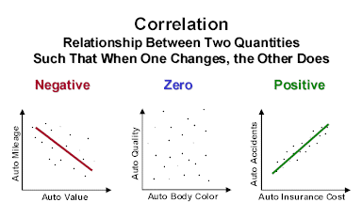
Scatterplot shows correlation between two variables.
To find the relationship, we can try to fit a line across this scatterplot that is the closest possible to ALL the points. This is a regression line.

Slide 22
Regression
reg traveltime cars
------------------------------------------------------------------------------
traveltime | Coef. Std. Err. t P>|t| [95% Conf. Interval]
-------------+----------------------------------------------------------------
cars | .0311483 .0004892 63.67 0.000 .0301888 .0321078
_cons | 14.7139 .2201573 66.83 0.000 14.28208 15.14571
-----------------------------------------------------------------------------
Statistics→ Linear model ->Linear Regression ->Dependent variable: traveltime,
Independent variable: cars
traveltime = 14.7 + 0.03cars What does it mean?

Slide 23
Drawing a linear function
Travel time = 14.7 + 0.03cars
Slope: 0.03
Travel time increase by 0.03 with each car.
Intercept
14.7
With an increase of 1000 cars, travel time increases by 1000*0.03 = 30 minutes. So with a thousand cars on the highway, total travel time is 14.7+30 = 44.7 minutes
With linear functions, an increase in X always increases Y by the same amount. For example, one additional car increase travel time by 0.03 minutes, regardless of whether there’s 100 or 1000 cars on the freeway.

Slide 24
Returning to the regression
reg traveltime cars
------------------------------------------------------------------------------
traveltime | Coef. Std. Err. t P>|t| [95% Conf. Interval]
-------------+----------------------------------------------------------------
cars | .0311483 .0004892 63.67 0.000 .0301888 .0321078
_cons | 14.7139 .2201573 66.83 0.000 14.28208 15.14571
-----------------------------------------------------------------------------
How confident can we be that travel time increases by 0.03 with each car?
The confidence interval tells us that we can be 95% confident that every car increases travel time by between 0.03 or 0.032 minutes.
The p-value tells us that the probability of finding a coefficient of 0.03 in this data when there is actually no relationship between travel time and number of cars is 0.000.

Slide 25
In contrast, here is the relationship between the ID number of the person who is recording the data, and travel time.
reg traveltime v1
------------------------------------------------------------------------------
traveltime | Coef. Std. Err. t P>|t| [95% Conf. Interval]
-------------+----------------------------------------------------------------
ID | -.0523915 .0433933 -1.21 0.227 -.1375025 .0327
_cons | 27.15703 .4200033 64.66 0.000 26.33324 27.9
------------------------------------------------------------------------------
The p-value tells us that the probability of finding a coefficient of 0.052 in this data when there is actually no relationship between travel time and number of cars is 0.227.
By convention, the cutoff p-value is noted with:
*** pval<0.01
** 0.01<=pval<0.05
* 0.05<= pval < 0.10.

Slide 26
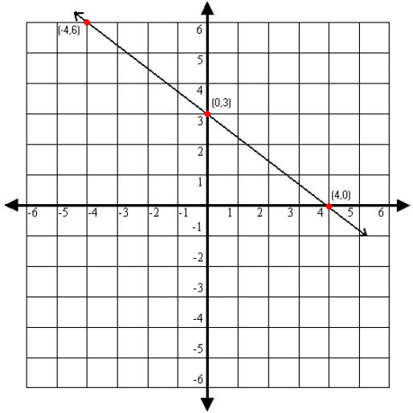
Looking at a graph and identifying the linear equation
Suppose this is a graph of your patience (y) as a function of traffic jams (x). What is the function?
Linear equations take the form of y=a+bx. So:
Step 1: Identify the vertical intercept (0,3) a=3
Step 2: Identify the horizontal intercept (4,0)
Step 3: calculate the slope
increase in y/increase in x
b = -3/4
(or rise over run)
So, function is y=3-3x/4

Slide 27
Inverting a linear function
traveltime = 14.7 + 0.03*cars
If it takes you 20 minutes to travel, how many cars are on a freeway?

Slide 28
Inverting a linear function
You know travel time as a function of cars
traveltime = 14.7 + 0.03*cars
You want cars as a function of travel time:
Traveltime- 14.7 = 0.03*cars
Cars = (Traveltime- 14.7) / 0.03
Cars = Traveltime/0.03- 14.7/0.03
Cars = 33.3*Traveltime - 490
Now, it’s easier to answer this question:
If it takes you 20 minutes to travel, how many cars are on a freeway?
Cars = 33.3*20 - 490 =176
(BTW: what is the intercept and slope of this inverted function?
Intercept = -490 Slope 33.3)

Slide 29
How many additional businesses should be allowed along a busy highway to maximize citizens satisfaction?
Breaking down the question into mathematical concepts
How long does it take to travel the highway? (random variable) On average 26.7 minutes.
How does the # of cars affect travel time? (correlation, linear regression, slope) Travel time = 14.7+0.03 cars
Can adoption of a different traffic system reduce congestion? (simultaneous equations)
How does the # of businesses affect # of cars?(nonlinear equations)
What is the optimal # of business to have? (optimization, derivatives, chain rule)

Slide 30
3. comparing two highways: should you adopt another traffic system?
(simultaneous equations, or, systems of equations)

Slide 31
Previously you learned that for Pittsburgh highways, traveltime = 14.7 + 0.03*cars.
A colleague suggested that in anticipation of congestion from the new businesses, you should consider a traffic system that has been adopted by Cleveland to reduce travelling time. There, traveltime = 8.7 + 0.05 cars.
Should you do that? What is the maximum # of cars such that travelling with the Cleveland system is faster than the Pittsburgh system?

Slide 32
Pittsburgh: Traveltime = 14.7 + 0.03 cars
Cleveland : Traveltime = 8.7 + 0.05 cars
The question asks for what is cars such that traveltime is equal to each other.
Several methods:
You can solve a linear systems by:
Graphing: draw both lines and see where they meet.
Substitution:
Traveltime = 8.7 + 0.05 cars
14.7 + 0.03 cars = 8.7 + 0.05 cars
6 = 0.02 cars.
Cars = 300
Given that mean # of cars on Pittsburgh highways is 385 (see data), the Cleveland system would actually cause more congestion.
Travel
time
cars

Slide 33
(A) 2x – 3y= 2
x + 2y= 8
Nature of Solutions to Systems
of Equations
y
5
(4, 2)
y
x
5
–5
5
(B) 4x + 6y= 12
2x + 3y= –6
x
–5
–5
5
Lines intersect at one point only.
Exactly one solution: x = 4, y = 2
y
–5
5
Lines are parallel
No solution.
(C) 2x – 3y = –6
–x + ³/₂ y = 3
5
x
–
5
–5
Lines coincide. Infinitely many solutions.
8-1-85

Slide 34
Review Exercise 1
Questions?

Slide 35
How many additional businesses should be allowed along a busy highway to maximize citizens satisfaction?
Breaking down the question into mathematical concepts
How long does it take to travel the highway? (random variable) On average 26.7 minutes.
How does the # of cars affect travel time? (correlation, linear regression, slope) Travel time = 14.7+0.03 cars
Han adoption of a different traffic system reduce congestion? (simultaneous equations) No.
How does the # of businesses affect # of cars?(nonlinear equations)
What is the optimal # of business to have? (optimization, derivatives)

Slide 36
4. Nonlinear function
We will now use our other data set, “business.csv”
This data set has the # of businesses on a highway and the # of commuter cars associated with these businesses.
what would new businesses do to highway congestion?

Slide 37
clear (you must clear out the old data)
Load new Business.csv
Look in data editor
What relationship are we trying to figure out?

Slide 38
scatter commutecars business
Is this a linear function?
Will a straight line
give you the smallest error?

Slide 39
Nonlinear functions
Let’s find what our function resembles:
Quadratic function
Logarithmic function
Exponential function

Slide 40
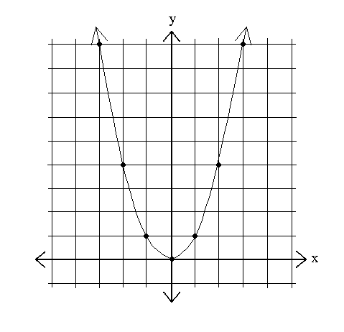
Quadratic function
y=x²
x | Y
-3 | 9
-2 | 4
-1 | 1
0 | 0
1 | 1
2 | 4
3 | 9
Notice how y changes as x changes.
The slope is no longer the same (“not a constant”) as we travel through the x axis: increasing x by 1 changes y by -5 at x=-3, by 1 at x=0, and by 3 if x=1

Slide 41
Slopes and derivatives
x | Y
-3 | 9
-2 | 4
-1 | 1
0 | 0
1 | 1
2 | 4
3 | 9
5
y=x²
1
1
2
3
As we discussed earlier, slope is the increase in y / increase in x.
So we can find an average slope between two points.
Average slope as x goes from 2 to 3 is (9-4)/(3-2) = 5
Average slope as x goes from 1 to 2 is (4-1)/(2-1) = 3
But how do we find the slope at the single point (x=2)? There’s nothing to measure!
Notes:
27.04 - 25

Slide 42
Slopes and derivatives
x | Y
-3 | 9
-2 | 4
-1 | 1
0 | 0
1 | 1
2 | 4
3 | 9
y=x²
dy/dx
Δx->0
1
2
3
But how do we find the slope at a single point (x) ? We can make up another point x+Δx where Δx is very small, so we have two points (x and x+Δx )and calculate the slope there.
The slope at x as we make Δx shrink to 0 is the derivative of y at x.
We write dx instead of “as Δx shrink to 0” so the derivative of y over x is usually written as dy/dx.
Notes:
27.04 - 25

Slide 43
The Recipe for Derivatives
the power rule:
Identify: m (constant), x (variable), c (exponent)
if y=mx^{c} , dy/dx= mcx^{c-1}
y=x² = 1x² constant=1, var =x, exponent=2.
dy/dx=1*2x⁽²⁻¹) =2x
So the derivative of x²at x=2 is 2*2 = 4
(note this is between 3 and 5 from slide 41)

Slide 44
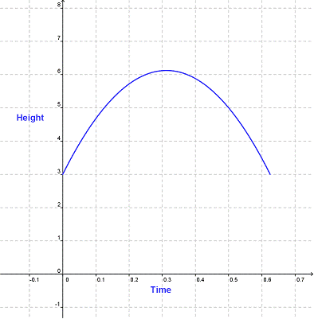
Other quadratic functions
y = ax² + bx + c
Is a>0 or a<0 here?
☺ ☹
Quadratic functions are one type of polynomial functions:

Slide 45
Working with polynomials more generally
Example:
Y=3x⁸+ 4x^{1/2} - 5x + 2/x+ 9 + 2x⁸
For each term, identify: m constant, x variable, c exponent (mx^{c})
Some special ones:
x= x¹
1/x= x⁻¹ 1/x²= x⁻²
1 =x⁰ x^{1/2} = sqrt(x)
Let’s write the polynomial such that we can easily identify the mx^{c} form:
Y=3x⁸+ 4x^{1/2} - 5x¹ + 2x⁻¹ + 9x⁰ +2x⁸

Slide 46
Rules for simplifying polynomials
Product rules | x ^{n} · x ^{m} = x ^{n+m} | 2³ · 2⁴ = 2³⁺⁴ = 128
 | x ^{n} · b ^{n} = (x · b) ^{n} | 3² · 4² = (3·4)² = 144
Quotient rules | x ^{n} / x ^{m} = x ^{n-m} | 2⁵ / 2³ = 2⁵⁻³ = 4
 | x ^{n} / b ^{n} = (x / b) ^{n} | 4³ / 2³ = (4/2)³ = 8
Power rules | (x ^{n}) ^{m} = x ^{n·m} | (2³)² = 2^{3·2} = 64
When will you use this in class? When you’re working with utility functions.

Slide 47
Derivatives: the “slope” at a point
the power rule:
if y=mx^{c} , dy/dx= mcx^{c-1}
Suppose y is the spread of a disease, x is poverty, and z is temperature, and you’re asked to find how poverty affect the spread of a disease.
y=3x³ + 4x³. Simplify first: 7x³. Then identify constant=7, var =x, exponent=3.
dy/dx=7*3x⁽³⁻¹) =21x²
y=3x²+ 8 constant=8, var =x, exponent=0.
dy/dx=6x + 8*0x⁽⁰⁻¹) =6x + 0 = 6x
y=3x²+ 8z constant=8z, var =x, exponent=0.
dy/dx=6x + 8z*0x⁽⁰⁻¹) =6x + 0 = 6x
y=x⁻¹ + 8z constant=1, var=x, exponent=-1.
dy/dx=1*-1x⁽⁻¹⁻¹⁾ + 0 = -1x⁻² = -1/x²
When will you use this in class? When you’re trying to figure out the rate of change in an outcome due to the implementation of a policy.

Slide 48
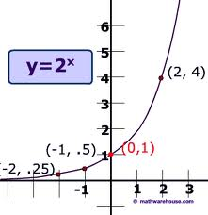
Exponential function
The growth of a terrorist cell:
At month 0 there’s 1 person 1
At month 1 this person recruited 2 people 2
At month 2 each persons recruited 2 people 4
What is the function that describe the growth?
f=2^{x} where x is time (month)
This is an exponential functions
Notice it “asymptotes” at the y axis.

Slide 49
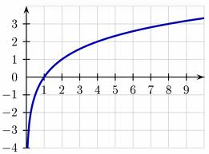
Logarithmic function
Time since the inception of the terrorist cell
If there is 1 member it must have just started t=0
If there are 2 members it must have been last month. t=1
If there are 32 members t =?
(5 months)
Equation: y=log₂x where x is # of members and y is months
"log_{a} x" means "to what power (exponent) must a be raised to get x?
This is the inverse
of the exponential function
Notice it “asymptotes” at the x axis.

Slide 50
Some rules for dealing with logs
Log₂ 2 = 1 since 2^1 = 2
Log₂ 4= 2 since 2^2 = 4
Log₂ 32 = Log₂ 2*16 = Log₂ 2 + Log₂ 16
since 2¹ * 2⁴ = 2⁵=16
Log₂ 1/16 = Log₂ 1 - Log₂ 16
since 2⁰ / 2⁴ = 2⁻⁴

Slide 51
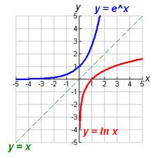
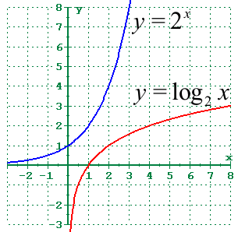
2^{x} and exp(x)
Logs and natural logs
Exp(x) = 2.72^{x}
This quantity is often used when quantities grow proportionally to it’s value. It is often seen in math, physics, and chemistry.
When will you use this? When you’re learning about logistic regressions.

Slide 52
We will mostly work with natural log (ln), because their derivatives are easier.
ln e = 1. since e^1 = e
ln ab = ln a + ln b.
ln a / b = ln a - ln b.
ln a^{n} = n ln a.
Compare:
y=log a (x) dy/dx= 1/ (x ln a)
With:
y=ln (x) dy/dx= 1/ x
Also,
y=e^{x} dy/dx=e^{x}
Notes:
because ln (x) = log e (x) , and ln e=1

Slide 53
So back to your data:
Quadratic?
Exponential?
Logarithmic?
Indeed, cars = 130+290*ln(business)

Slide 54
5. what is the optimal # of business to have? (optimization, compound functions)

Slide 55
How do we optimize a function?
Suppose this is Y = 8X-.8X²
How can we find X where Y is at a maximum?
Find x where the slope of Y is 0

Slide 56
General Optimization
Recall power rule: if Y=mx^{c} , dY/dX= mcx^{c-1}
Supposed want to maximize a function:
Y = 8X-.8X²
First we have to take a derivative:
dY/dx = 8*1X¹⁻¹-.8*2X²⁻¹
= 8-1.6X
Then when we set it to 0, we can solve for X that maximizes the function
8-1.6X = 0
8 = 1.6X
X=5

Slide 57
X | Y
0 | 0
1 | 7.2
2 | 12.8
3 | 16.8
4 | 19.2
5 | 20
6 | 19.2
7 | 16.8
8 | 12.8
9 | 7.2
10 | 0
11 | -8.8
12 | -19.2
Y = 8X-0.8X²
dY/dX = 8 – 0.8*2*X = 8-1.6X

Slide 58
How many businesses should be on the highway?
Let’s break this down:
How does business affect travel time?
  We know how cars affect travel time
  And we know how businesses affect cars.
Suppose his public opinion expert says:
complaints = travel time,
praise = # of business²/2
Then how can he maximize:
praise – complaints ?

Slide 59
You have cars and traveltime.
cars = 130+290*ln(business)
You have business and cars.
traveltime = 14.7 + 0.03*cars
How do you combine them?
traveltime = 14.7 + 0.03* (130+290*ln(business) )
traveltime = 18.6+8.7ln(business)

Slide 60
Now we are ready to use the info from the public opinions guy:
Praise = # of business²/2
Complaints = traveltime = 18.6+8.7ln(business)
We want to maximize: Benefit= Praise – Complaints
Benefit = business²/2 -18.6-8.7ln(business)
Take derivative:
d Benefit / d business = business – 8.7/business
Set to 0, we get:
0 = business – 8.7/business
8.7/business = business
8.7 = business²
Optimal number of business = sqrt(8.7) = 2.95 or 3 businesses

Slide 61
Exercise 2
Break

Slide 62
Review Exercise 2
Any questions?

Slide 63
Writing and saving commands in STATA
In your classes (and in your job in the future) you will want more control over what you did to the data and replicability.
This is so you can remember what you did and that others can replicate your results.
This is harder to do with the menu bar.
  Go to Window, Do File Editor, and choose New Do-file Editor.
  This will open a new .do file.
  Write your commands in it.
  Highlight one of the commands and click the “Execute (do)” icon. It should run the command. You can also copy and paste directly to the command window.
  Save this file as MathCamp.do
  Continue adding commands into this file.

Slide 64
Loading and exploring
Clearing memory: clear
Loading .csv file: cars.csv
See all variables: sum
String variables (highway) vs numeric variables
Tab highway
Variable | Obs Mean Std. Dev. Min Max
-------------+---------------------------------------------------------
cars | 1,674 385.3883 232.479 0 1230
traveltime | 1,674 26.71808 8.605933 11.16805 61.63294
highway | 0
ID | 1,674 8.378136 4.848058 0 17
.

Slide 65
Relationship between variables
Pwcorr (correlation)
Reg traveltime cars
Scatter traveltime cars

Slide 66
Sorting and Viewing Data
gsort
Sort in both order
Ascending: gsort cars
Descending: gsort -cars
Sort
Only sort in ascending order
List
.
gsort cars
. list in 1/5
+----------------------------------+
v1 cars travel~e highway
----------------------------------
1. 1153 0 18.31223 Roscoe
2. 1532 0 15.03788 Roscoe
3. 1321 0 15.07491 Roscoe
4. 170 0 18.04261 Robb
5. 822 0 12.8783 Jemison
+----------------------------------+
. list in -5/L
+----------------------------------+
v1 cars travel~e highway
----------------------------------
1670. 220 1170 57.35289 Robb
1671. 253 1190 45.25637 Robb
1672. 554 1210 55.85953 Clarion
1673. 1390 1220 54.14872 Roscoe
1674. 59 1230 47.82588 Roscoe
+----------------------------------+

Slide 67
Conditional statements and working with strings
(if, and (&), or (|), ==, != )
sum traveltime if cars < 100
mean traveltime if cars > 150 & cars < 200
reg traveltime cars if highway !=“SqHill”
sum traveltime if highway ==“SqHill” | highway == “Clarion”
list traveltime if highway ==“SqHill” & cars > 400

Slide 68
Generating new variables
gen: simple transformations of other variables
  gen travelsq = traveltime^2
What if you mess up making a variable and want to recreate it? Eg. You want travelsq to be ½*traveltime^2
drop travelsq
  gen travelsq = (1/2)* traveltime^2
  Can combine gen with logical statements :
  gen toocrowded = (cars>400)
  Using your new variable:
  reg traveltime cars if toocrowded
  reg traveltime cars if !toocrowded
  reg traveltime toocrowded

Slide 69
Graphing
Comparing two subgroups:
twoway (scatter traveltime cars if toocrowded) (scatter traveltime cars if !toocrowded)
twoway (scatter traveltime cars if highway==“Roscoe”) (scatter traveltime cars if highway==“Robb”)
Comparing two version of traveltime:
twoway (scatter traveltime cars) (scatter travelsq cars)
How to save your graphs?
File– Save As – (I usually do .pdf)
Or: Win users: right click and click Copy and then paste into your word doc.

Slide 70
Review Exercise 3
Any questions?

Slide 71
On to the Race!
Show Race Packet Materials.
Tomorrow: you will absolutely need your computer.
You will be coding and thinking and racing from room to room, so make sure you are comfortable.
There will be 10 clues. Solving each clue in three tries or less will earn your team 1 point. The team with the highest number of points wins the race. Ties are broken by how quickly you complete the race.
There will be Roadblocks. In Roadblocks each person in the team must solve a puzzle individually. The point will only be given if both team members successfully solve their puzzle.

Slide 72
How to win?
Review all the material tonight with your teammate and decide on how you want to handle roadblocks and other scenarios. The math will be simple but will require creative applications.
Stata commands: You MUST get familiar with all the commands we did today.
When getting your answers checked you can send just one person so one of you can continue working.
Tomorrow: you can setup starting from 12pm. We will distribute materials for the race at 1pm
On to work with your teammate! (Group exercise)

Slide 73

Training done!

