Slide 1
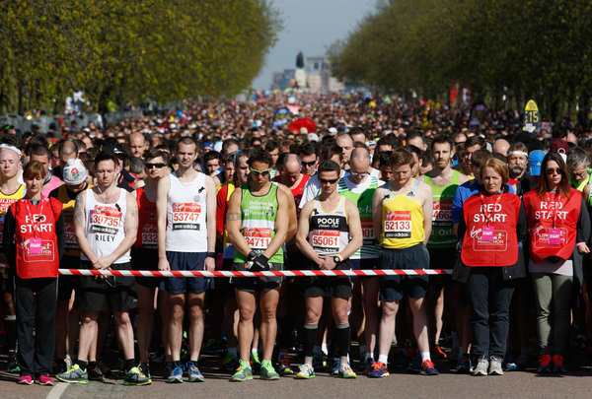
2019 GSPIA Amazing Analytics Race
Wednesday Training Camp
Sera Linardi
Associate Professor of Economics

Slide 2
9:00am Getting ready: Your To-Do List
IT: Tekky Bambang
TA: Kristin Ronzi
Get the name of 2 new people around you.
Register and find your ID number on your name tag
Get STATA if you haven’t already. Open STATA.
Go to http://www.linardi.gspia.pitt.edu/?page_id=564 for the schedule. If you are unable to get online, talk to Tekky or Kristin.
Download all materials for Wednesday into a folder in your computer.
Click on Exercise: Baseline and try it. Use the ID # from your name tag.
We start lecture at 9:30am.

Slide 3
Welcome
Sera Linardi (linardi@pitt.edu)
PhD in Social Science, California Institute of Technology
Behavioral / experimental economist
SP 20 classes: Behavioral Econ & Game Theory, R Data Visualization
Starting a new center at GSPIA: Center for Analytics in Social Innovation (CASI) to bring analytical tools to public services.
Example of CASI projects:
PittSmartLiving (NSF Transport project)
Field experiment encouraging
ex-inmates to use social services.

Slide 4


https://www.youtube.com/watch?v=s90dp-8oA6o
Talk on Pitt Smart Living Human Behavior Lab

Slide 5
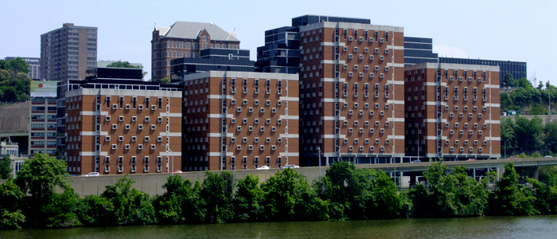
Allegheny County Jail, Pittsburgh, PA

Slide 6
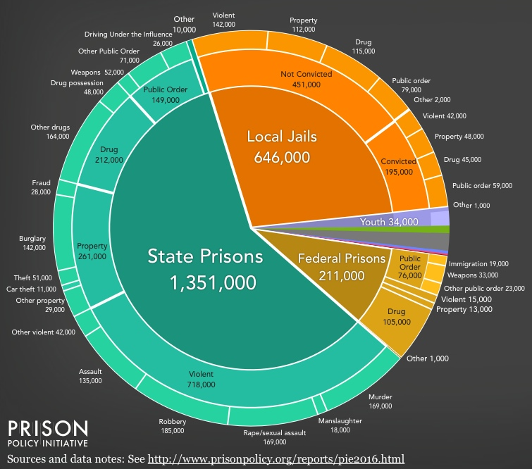
Jail churn
Most people in jail has not been convicted.
The median stay was 10 days, and the mean stay was 58.3 days.

Slide 7

Notes:
Foundation of HOPE
The HOPE Pre-Release and Aftercare programs are inter-faith, faith-based, rehabilitative programs which work in collaboration with key community service providers and volunteers to empower incarcerated and released individuals to restore their relationship with their God, rebuild their lives, and reconcile to their community.
HOPE Pre-Release Program
Over an eight week period, HOPE Pre-Release participants meet for over 120 hours of group work, requiring full participation and the passing of a final exam. Graduates participate in a graduation ceremony and receive a certificate, letter for court, small gift, and a contact visit. The participants live together on the HOPE pods; 4E for the women and 2C for the men. Participants may remain in the HOPE program after graduation.
Among others, the HOPE Pre-Release Program addresses the following key themes:
Addiction and Recovery
Anger Management
Confronting “Stinking Thinking”
Life Skills
Parenting
Release and Reintegration
Spiritual Formation
HOPE Aftercare
Each HOPE participant (also known as a mentee) is eligible to be matched with a trained mentor who will offer the mentee support over a one-year period, beginning when the participant is in jail. Each HOPE mentor will be available to support the mentee in making a healthy transition to society. This may include joining the mentee at recovery meetings, encouraging with job and housing search, meeting with the mentee’s Probation Officer and family, and inviting the mentee to fellowship with a community of faith.

Slide 8
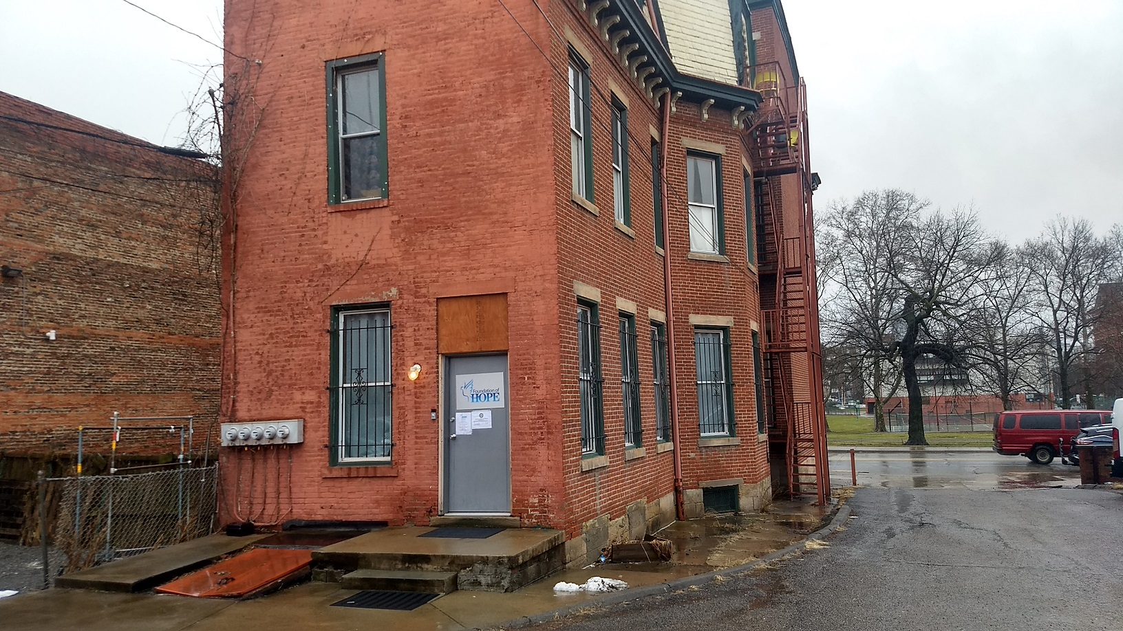

Slide 11

Punch card = No incentive
AFTERCARE
112 W. North Avenue, PA 15212
(412) 321-3343
This card is provided by our external partner and is of limited availability.
Name:________________________
Card #:_______________________
Date: ______________________ R:Y/N
Please aim to use at least
five (5) services in a year.
Front
Back

Slide 12
Punch card: 3 visits to get incentive
AFTERCARE
112 W. North Avenue, PA 15212
(412) 321-3343
This frequent user card is provided by our external partner and is of limited availability.
NH 10/11/18
VP 10/13/18
Name:________________________
Card #:_______________________
Date: _____________________ R:Y/N
Redeem for a $50 gift when you use
at least five (5) services in a year.
Front
Back

Slide 13
Punch card: 5 visits to get incentive
AFTERCARE
112 W. North Avenue, PA 15212
(412) 321-3343
This frequent user card is provided by our external partner and is of limited availability.
Name:________________________
Card #:_______________________
Date: ______________________R:Y/N
Redeem for a $50 gift when you use
at least five (5) services in a year.
Front
Back

Slide 14
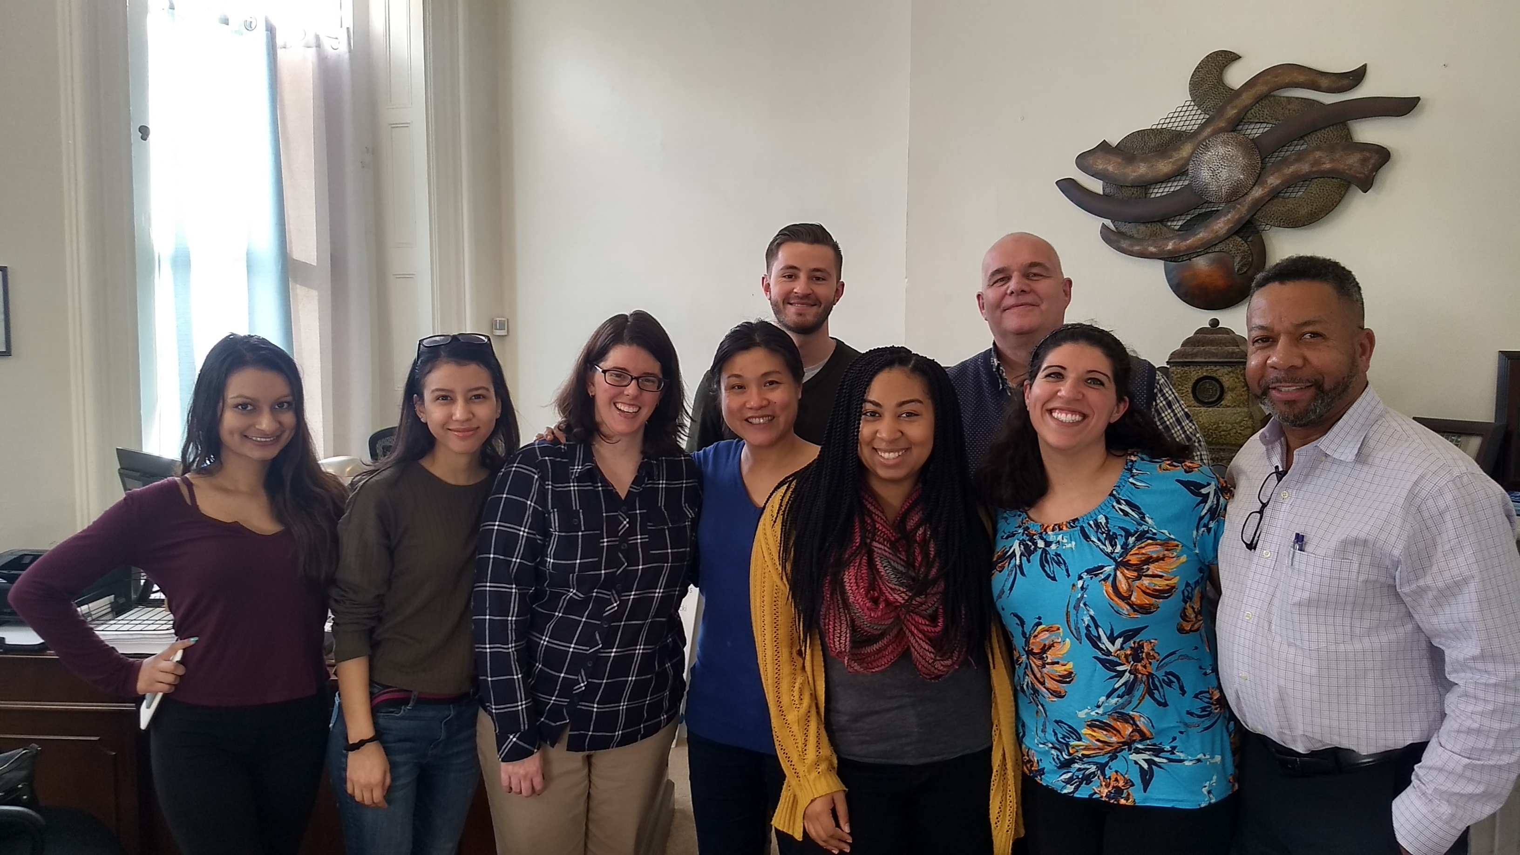

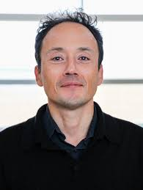



Slide 15
Effect of incentive so far (ongoing)

Slide 16
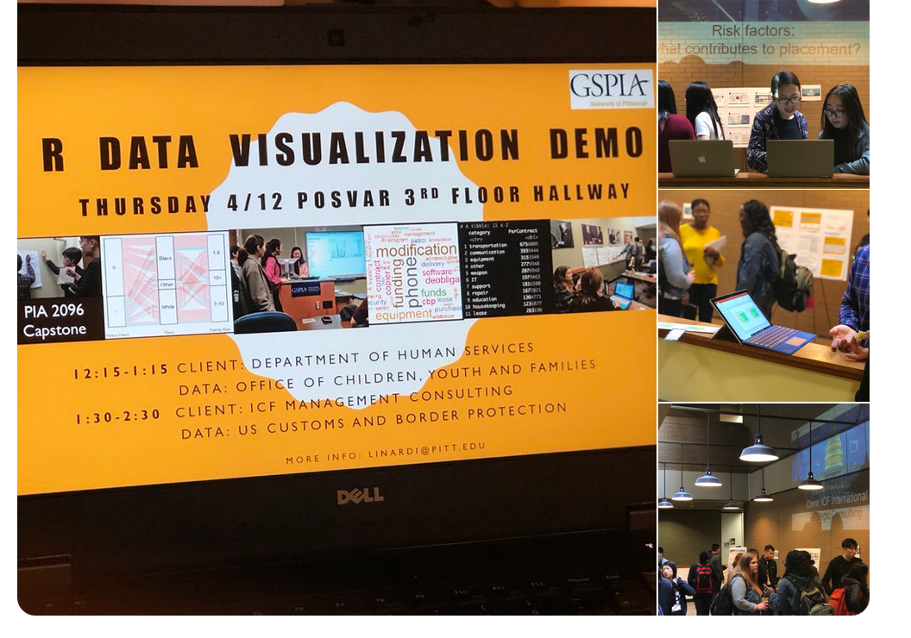
Example of CASI activities:
Amazing Analytics Race (tomorrow!)
Reading group: Econ Meets CS (Tues 11-12), led by postdoc Jinyong Jeong. Will be offered as a class Spring 2020.
R programming data visualization demo

Slide 17
What this workshop is and is NOT
What are we doing today? We are beginning your GSPIA journey with the end in mind: a career solving real world problems
First, let’s define what this workshop will NOT do:
Guarantee you an A in Quant I or Micro or any quant class
Make you a math whiz
Explain any mathematical concept in depth
What this workshop aims to do:
Connect quant methods to the real world.
Give you a preview of ALL the math you will see during your time here. You will most likely not encounter any math that you have not seen today.
Provide a quick-and-dirty, hands-on experience of how quant methods give you an additional edge in tackling policy questions.

Slide 18

Schedule and people you will meet today
9:30-10:50 Intro, Lecture 1: Linear functions, Exercise 1
10:50-11:10 Meet your quant professors
11:10-11:20 Break
11:20-12:00 Lecture 2: Nonlinear functions and derivatives, Exercise 2
12:00-1:00 Lunch Break
1:00-1:15pm Amazing Analytics Race teams (TAs)
1:15-2:45 Lecture 3: Intro to Stats, Exercise 3
2:45-3:00pm Break
3:00pm-3:30pm Team exercise and alum Alex Heit

Slide 19
And.. what is GSPIA’s
Amazing Analytics Race ?
At the end of today, you will be randomly split into pairs for tomorrow.
Your mission will be explained tomorrow: you will have 3 hours to solve a puzzle by interlocking a series of 10 clues with your partner.
You will use real world data, the quantitative methods you learn today, and lots of creativity.
What’s at stake: 1st place team = a $200 Bookstore gift certificate. 2nd place team = $100. 3rd place = $50.
After teams are formed today, we will brief you on the rules of the race, and your team will get to practice working together.

Slide 20


Our Amazing Race Community Partner
Claire Suh, Microsoft Civic Tech Fellow and David Walker, WPRDC Data Scientist

Slide 21
How today’s training camp works
Data - Lecture (<1hr)– Exercise (10 mins) – Review the exercise (5-10 mins)
You have the slides on your computer, so you can always go back / make notes, etc.
Ask questions! There is no dumb question, this is a refresher workshop so forgetting basic stuff is totally okay. In completing exercise feel free to ask your neighbors/TAs/instructor for help.
Please don’t browse the internet/ phone for unrelated stuff. If you are waiting for others to finish, see if anyone near you needs help, or try new things with STATA.

Slide 22
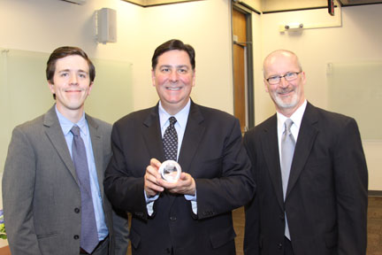
Imagine you are an advisor to the mayor of Pittsburgh
Peduto, GSPIA’11
He is wondering whether or not to approve 10 new businesses on a strip of a crowded highway: businesses bring jobs but worsen congestion
What you have to help you advise him:
  Data on travel time on several highways given the number of cars on the highway (Cars.csv)
  Data on number of cars given number of businesses along the highway (Business.csv)
  Public opinion expert’s estimated relationship between business development, traffic congestion and support for city government
Notes:
Hourly average for cars and travel time.

Slide 23
Breaking down the question into mathematical concepts
how long does it take to travel the highway? (random variable)
how does the # (number) of cars affect travel time? (correlation, linear regression, slope)
can adoption of a different traffic system reduce congestion? (simultaneous equations)
how does the # of businesses affect # of cars?(nonlinear equations)
what is the optimal # of business to have? (optimization)

Slide 24

1. random variable
How long does it take to travel through the highway?

Slide 25
Random variable
How long does it take to travel 20 miles on a city highway at 8am in the morning? Hands = 20 mins, 30 mins, 40 mins
Different day, same highway, same hour in day = different travel time.
Statistics is learning to get the information out of this uncertainty.
‘Time needed to travel’ is a random variable = the value is subject to variation due to chance.
Is what is written on this board ALL the possible travel times for 20 miles? No. That would be the population. This is a sample. We usually only observe a sample of realizations of the random variable of interest.

Slide 26
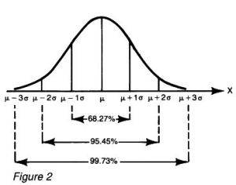
Distribution: what the population looks like
Suppose the distribution of travel time looks like this:
10
15
20
25
30

Slide 27
Distribution: what the population looks like
Then we can say that travel time is distributed normally with a mean 20 minutes and a std deviation of 5 minutes.
(or a variance of 5²=25)
We want to ask:
Pr (travel>20 min) =?
Pr (travel>25 min) =?
Pr (travel>15 min) =?
10
15
20
25
30

Slide 28
Let’s look at the normal distribution more generally:
Earlier we drew this for µ=20, σ=5
Notes:
This is a normal distribution: notice its symmetric about its mean.

Slide 29
Recall this? 95% confidence interval
Notes:
This is a normal distribution: notice its symmetric about its mean.

Slide 30
Let’s look at the normal distribution more generally:
Travel time:
µ=20, σ=5
Pr (travel>20 min) =
Pr (travel>25 min) =
Pr (travel>15 min) =
50%
16%
100%-16%
16%
(100%-68%) /2 = 16%
Notes:
This is a normal distribution: notice its symmetric about its mean.
Things follow some simple rules with the normal distribution:
Prob of being late when you give yourself 20 minutes is (100%) / 2 = 50%
Prob of being late when you give yourself 20+5 minutes is (100%-68%) / 2 = 16%
Prob of being late when you give yourself 20-5 minutes is 68%+16% = 84%
Prob of being late when you give yourself 20+2*5 minutes is (100%-95.45%) / 2 = 2.275%

Slide 31
Your turn
Travel time:
µ=20, σ=5
Pr (travel>30 min) = ?
10
15
20
25
30
Notes:
This is a normal distribution: notice its symmetric about its mean.
Things follow some simple rules with the normal distribution:
Prob of being late when you give yourself 20 minutes is (100%) / 2 = 50%
Prob of being late when you give yourself 20+5 minutes is (100%-68%) / 2 = 16%
Prob of being late when you give yourself 20-5 minutes is 68%+16% = 84%
Prob of being late when you give yourself 20+2*5 minutes is (100%-95.45%) / 2 = 2.275%

Slide 32
Joint probabilities
Probability that John & Beth (who travelled separately) are both late when
they each gave themselves 20 minutes?
John left 20 minutes ago while Beth left 25 minutes ago?

Slide 33
SIDEBAR: joint vs conditional probability
JOINT: Tossing a coin and a dice what is the probability you get a H and an even number?
CONDITIONAL : You toss a dice and got an even number. What is the probability that the number is < 4?

Slide 34
Looking at data in STATA
Suppose cars.csv contains a random sample of travel time and # of cars on Pittsburgh highways.
Let’s load it with Data Editor. Open cars.csv in Excel. Highlight, copy. Open data editor. Click on first cell and paste. Treat first row as variable name.
Again: all just quick and dirty today!

Slide 35
Histogram
Travel time
hist traveltime (not normal, but we’ll treat it as such today)
Graphics → Histogram ->Variable: traveltime
Notes:
Min (excluding outliers), lower quartile (25% data less than this value), median, upper quartile, max, outliers.

Slide 36
According to this sample, the average time needed to travel 20 miles on a Pittsburgh highway is 26.7 minutes.
Notes:
This means: 95% of the time, when we calculate a confidence interval in this way (take a sample and compute the CI), the true mean will be between the two values. 5% of the time, it will not.

Slide 37
The standard error of the mean travel time is 0.21 minutes. This means when we take random sample of 1674 car trips down this highway, the average travel time will fluctuate by 0.21.

Slide 38
2. correlation, linear regression, slope / rate / derivative
how does the # of cars affect travel time?

Slide 39
Relationship between two random variables correlation between travel time and # of cars
If we can describe this relationship with an equation, we can tell how travel time is affected by cars more generally.
scatter traveltime cars
Graphics → Twoway ->Create->Y variable: traveltime, X variable: cars

Slide 40
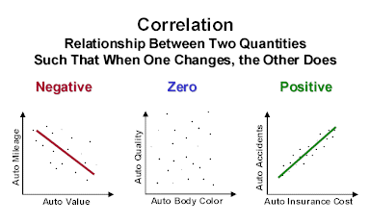
Scatterplot shows correlation between two variables.
To find the relationship, we can try to fit a line across this scatterplot that is the closest possible to ALL the points. This is a regression line.

Slide 41
Regression
reg traveltime cars
------------------------------------------------------------------------------
traveltime | Coef. Std. Err. t P>|t| [95% Conf. Int]
-------------+----------------------------------------------------------------
cars | .031 .000489 63.67 0.000 .03019 .0321
_cons | 14.714 .220157 66.83 0.000 14.28 15.146
-----------------------------------------------------------------------------
traveltime = 14.7 + 0.03cars
What does it mean?

Slide 42
Drawing a linear function
Travel time = 14.7 + 0.03cars
Slope: 0.03
Travel time increase by 0.03 with each car.
Intercept
14.7
With an increase of 1000 cars, travel time increases by 1000*0.03 = 30 minutes. So with a thousand cars on the highway, total travel time is 14.7+30 = 44.7 minutes

Slide 43
Linear Functions
With linear functions, an increase in X always increases Y by the same amount. For example, one additional car increase travel time by 0.03 minutes, regardless of whether there’s 100 or 1000 cars on the freeway.
Hint: marginal analysis useful in Cost-Benefit Analysis and in Micro. The regression finds that the marginal impact of 1 car on congestion is 0.03 minutes in travel time.

Slide 44
Inverting a linear function
traveltime = 14.7 + 0.03*cars
If it takes you 20 minutes to travel, how many cars are on a freeway?
Hint: useful in microeconomics in inverting demand curves

Slide 45
Inverting a linear function
You know travel time as a function of cars
traveltime = 14.7 + 0.03*cars
You want cars as a function of travel time:
Traveltime- 14.7 = 0.03*cars
Cars = (Traveltime- 14.7) / 0.03
Cars = Traveltime/0.03- 14.7/0.03
Cars = 33.3*Traveltime - 490
Now, it’s easier to answer this question:
If it takes you 20 minutes to travel, how many cars are on a freeway?
Cars = 33.3*20 - 490 =176
(BTW: what is the intercept and slope of this inverted function?
Intercept = -490 Slope 33.3)

Slide 46
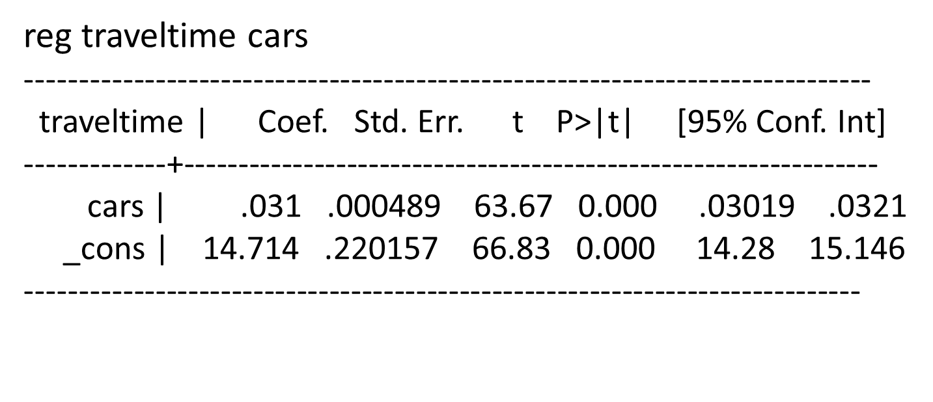
Confidence interval in regressions
The confidence interval tells us that we can be 95% confident that every car increases travel time by between 0.03 or 0.032 minutes.

Slide 47
P values in regressions
The p-value tells us that the probability of finding a coefficient of 0.03 in this data when there is actually no relationship between travel time and number of cars is 0.000

Slide 48
Contrast: p value when there is no correlation
Relationship between the ID # of public works official recording the data and travel time.
traveltime | Coef. Std. Err. t P>|t| [95% Conf. Interval]
-------------+----------------------------------------------------------------
ID | -.0524 .043 -1.21 0.227 -.1375 .0327
_cons | 27.16 .420 64.66 0.000 26.3 27.9
------------------------------------------------------------------------------
The probability of finding a coefficient of -0.05 in this data when there is actually no relationship between travel time and the ID of the person recording the data is 22.7%

Slide 49
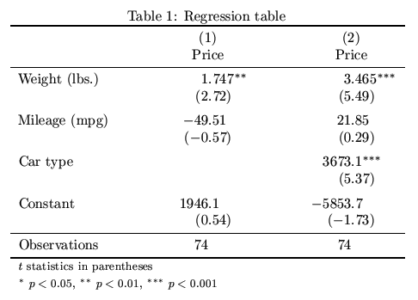
SIDEBAR:
By convention, cutoffs p-value is noted with *:
Hint: useful in any class where you need to read papers with empirical results.

Slide 50
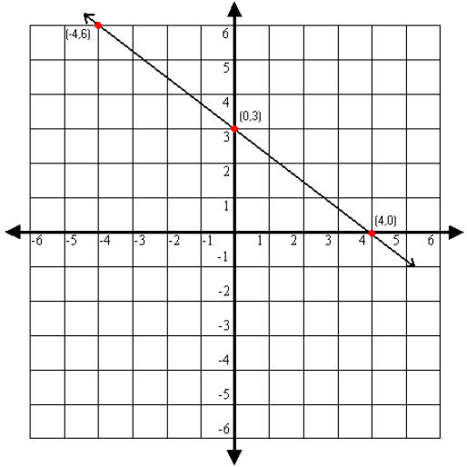
Looking at a graph and identifying the linear equation: y=a+bx
Patience
Traffic jam
Patience = 3 – 3Traffic jam/4

Slide 51
Looking at a graph and identifying the linear equation
Steps:
Linear equations take the form of y=a+bx. So:
Step 1: Identify the vertical intercept (0,3) a=3
Step 2: Identify the horizontal intercept (4,0)
Step 3: calculate the slope
increase in y/increase in x
b = -3/4
(or rise over run)
So, function is y=3-3x/4

Slide 52
How many additional businesses should be allowed along a busy highway to maximize citizens satisfaction?
Breaking down the question into mathematical concepts
How long does it take to travel the highway? (random variable) On average 26.7 minutes.
How does the # of cars affect travel time? (correlation, linear regression, slope) Travel time = 14.7+0.03 cars
Can adoption of a different traffic system reduce congestion? (simultaneous equations)
How does the # of businesses affect # of cars?(nonlinear equations)
What is the optimal # of business to have? (optimization, derivatives, chain rule)

Slide 53
3. comparing two highways: should you adopt another traffic system?
(simultaneous equations, or, systems of equations)

Slide 54
Previously you learned that for Pittsburgh highways, traveltime = 14.7 + 0.03*cars.
A colleague suggested that in anticipation of congestion from the new businesses, you should consider a traffic system that has been adopted by Cleveland to reduce travelling time. There, traveltime = 8.7 + 0.05 cars.
Should you do that? What is the maximum # of cars such that travelling with the Cleveland system is faster than the Pittsburgh system?

Slide 55
Pittsburgh: Traveltime = 14.7 + 0.03 cars
Cleveland : Traveltime = 8.7 + 0.05 cars
The question asks for what is cars such that traveltime is equal to each other.
Traveltime = 8.7 + 0.05 cars
14.7 + 0.03 cars = 8.7 + 0.05 cars
6 = 0.02 cars.
Cars = 300
What’s the average # of cars in the Pittsburgh highway of interest?
Which system is better?
Travel
time
cars

Slide 56
Review Exercise 1
Questions?

Slide 57
Schedule and people you will meet today
9:30-10:50 Intro, Lecture 1: Linear functions, Exercise 1
10:50-11:10 Meet your quant professors
11:10-11:20 Break
11:20-12:00 Lecture 2: Nonlinear functions and derivatives, Exercise 2
12:00-1:00 Lunch Break
1:00-1:15pm Amazing Analytics Race teams (TAs)
1:15-2:45 Lecture 3: Intro to Stats, Exercise 3
2:45-3:00pm Break
3:00pm-3:30pm Team exercise and alum Alex Heit

Slide 58
How many additional businesses should be allowed along a busy highway to maximize citizens satisfaction?
Breaking down the question into mathematical concepts
How long does it take to travel the highway? (random variable) On average 26.7 minutes.
How does the # of cars affect travel time? (correlation, linear regression, slope) Travel time = 14.7+0.03 cars
Can adoption of a different traffic system reduce congestion? (simultaneous equations) No.
How does the # of businesses affect # of cars?(nonlinear equations)
What is the optimal # of business to have? (optimization, derivatives)

Slide 59
4. Nonlinear function
We will now use our other data set, “business.csv”
This data set has the # of businesses on a highway and the # of commuter cars associated with these businesses.
what would new businesses do to highway congestion?

Slide 60
clear (you must clear out the old data)
Load new Business.csv
Look in data editor
What relationship are we trying to figure out?

Slide 61
scatter commutecars business
Is this a linear function?
Will a straight line
give you the smallest error?

Slide 62
Nonlinear functions
Let’s find what our function resembles:
Quadratic function
Logarithmic function
Exponential function

Slide 63
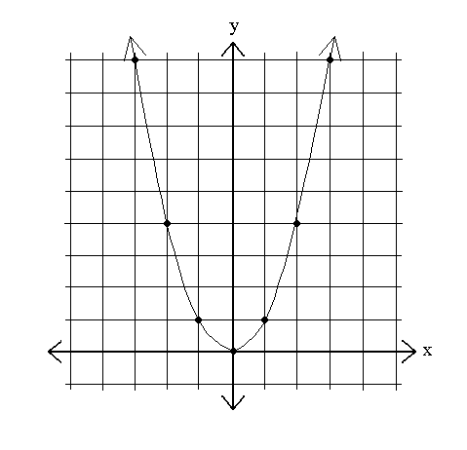
Quadratic function
y=x²
x | Y
-3 | 9
-2 | 4
-1 | 1
0 | 0
1 | 1
2 | 4
3 | 9
Notice how y changes as x changes.
The slope is no longer the same (“not a constant”) as we travel through the x axis: increasing x by 1 changes y by -5 at x=-3, by 1 at x=0, and by 3 if x=1

Slide 64
Slopes and derivatives
x | Y
-3 | 9
-2 | 4
-1 | 1
0 | 0
1 | 1
2 | 4
3 | 9
5
y=x²
1
1
2
3
As we discussed earlier, slope is the increase in y / increase in x.
So we can find an average slope between two points.
Average slope as x goes from 2 to 3 is (9-4)/(3-2) = 5
Average slope as x goes from 1 to 2 is (4-1)/(2-1) = 3
But how do we find the slope at the single point (x=2)? There’s nothing to measure!
Notes:
27.04 - 25

Slide 65
Slopes and derivatives
x | Y
-3 | 9
-2 | 4
-1 | 1
0 | 0
1 | 1
2 | 4
3 | 9
y=x²
dy/dx
Δx->0
1
2
3
But how do we find the slope at a single point (x) ? We can make up another point x+Δx where Δx is very small, so we have two points (x and x+Δx )and calculate the slope there.
The slope at x as we make Δx shrink to 0 is the derivative of y at x.
We write dx instead of “as Δx shrink to 0” so the derivative of y over x is usually written as dy/dx.
Notes:
27.04 - 25

Slide 66
The Recipe for Derivatives
the power rule:
Identify: m (constant), x (variable), c (exponent)
if y=mx^{c} , dy/dx= mcx^{c-1}
y=x² = 1x² constant=1, var =x, exponent=2.
dy/dx=1*2x⁽²⁻¹) =2x
So the derivative of x²at x=2 is 2*2 = 4
(note this is between 3 and 5 from slide 41)

Slide 67
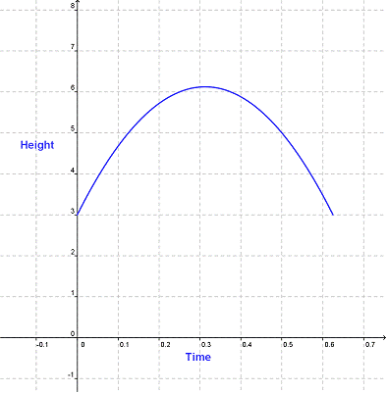
Other quadratic functions
y = ax² + bx + c
Is a>0 or a<0 here?
☺ ☹
Quadratic functions are one type of polynomial functions:

Slide 68
Rules for simplifying polynomials
Product rules | x ^{n} · x ^{m} = x ^{n+m} | 2^{3.}·2⁴ = 2³⁺⁴ = 128
 | x ^{n} ·b ^{n} = (x·b) ^{n} | 3²·4² = (3·4)² = 144
Quotient rules | x ^{n} / x ^{m} = x ^{n-m} | 2⁵/2³ = 2⁵⁻³ = 4
 | x ^{n} / b ^{n} = (x / b) ^{n} | 4³/2³ = (4/2)³ = 8
Power rules | (x ^{n}) ^{m} = x ^{n·m} | (2³)² = 2^{3·2} = 64
Hint: Maybe useful when working with utility functions in microeconomics.

Slide 69
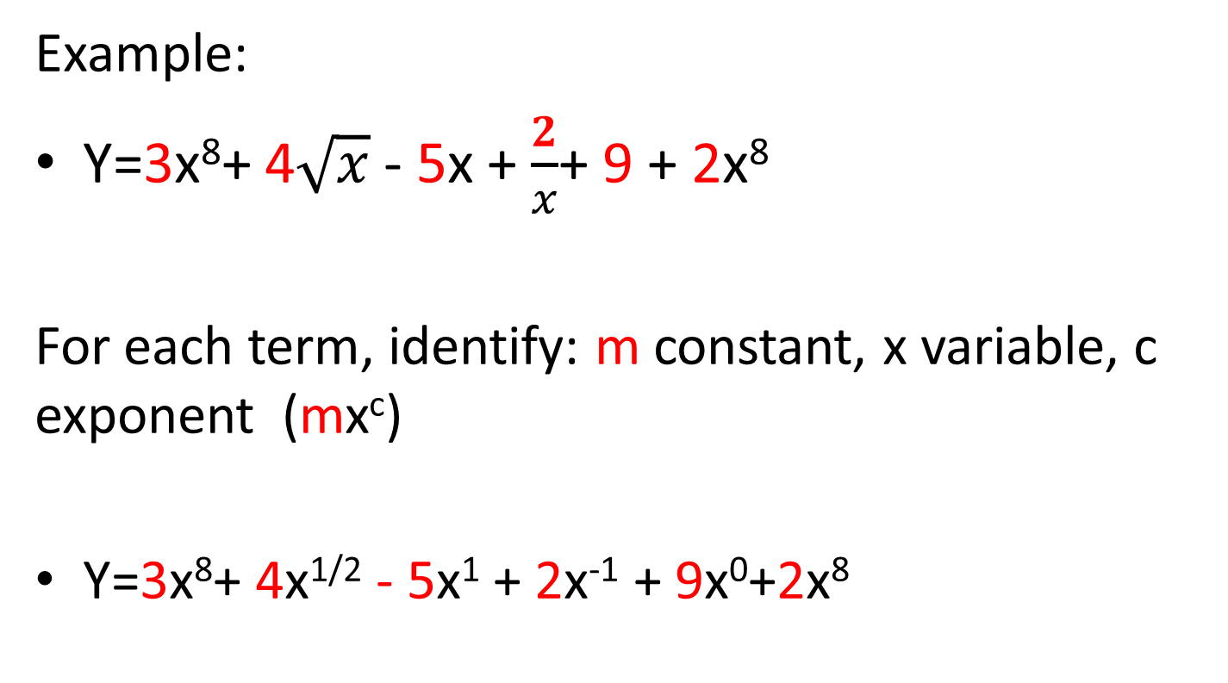
mx^{c} in general polynomials
Example:
Y=3x⁸+ 4$\sqrt{x}$ - 5x + $\frac{2}{x}$+ 9 + 2x⁸
For each term, identify: m constant, x variable, c exponent (mx^{c})
Y=3x⁸+ 4x^{1/2} - 5x¹ + 2x⁻¹ + 9x⁰+2x⁸

Slide 70
the power rule: if y=mx^{c} , dy/dx= mcx^{c-1}
Suppose y is the spread of a disease, x is % of population below poverty line, and z is temperature. How does a 1 unit increase in poverty affect the disease?
y=3x³ + 4x³. Simplify first: 7x³. Then identify constant=7, var =x, exponent=3.
dy/dx=7*3x⁽³⁻¹) =21x²
y=3x²+ 8 constant=8, var =x, exponent=0.
dy/dx=6x + 8*0x⁽⁰⁻¹) =6x + 0 = 6x
y=3x²+ 8z constant=8z, var =x, exponent=0.
dy/dx=6x + 8z*0x⁽⁰⁻¹) =6x + 0 = 6x
When will you use this in class? When you’re trying to figure out the rate of change in an outcome due to the implementation of a policy.

Slide 71
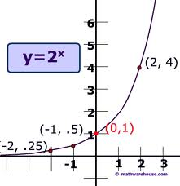
Exponential function
The growth of a terrorist cell:
At month 0 there’s 1 person 1
At month 1 this person recruited 2 people 2
At month 2 each persons recruited 2 people 4
What is the function that describe the growth?
f=2^{x} where x is time (month)
This is an exponential functions
Notice it “asymptotes” at the y axis.

Slide 72
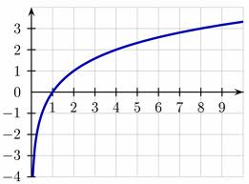
Logarithmic function
Time since the inception of the terrorist cell
If there is 1 member (x=1) , y=0 months
If there are 2 members (x=2) , y=1
If there are 8 members (x=3)
inverse of the exponential function
Notice it “asymptotes” at the x axis.
: y=log₂x

Slide 73
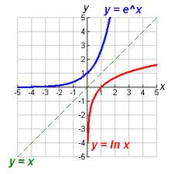
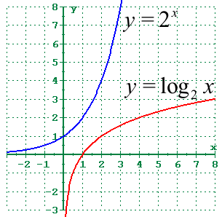
2^{x} and exp(x) = 2.72^x
Logs and natural logs
In practice when you see y=log(x) it’s usually y=ln(x) than y=log_{k}(x). This is because if y=ln(x), dy/dx is just 1/x
When will you use this? When you’re learning about logistic regressions.

Slide 74
So back to your data:
Quadratic?
Exponential?
Logarithmic?
Indeed, cars = 130+290*ln(business)

Slide 75
5. what is the optimal # of business to have? (optimization, compound functions)

Slide 76
How many businesses should be on the highway?
Let’s break this down:
How does business affect travel time?
  We know: cars = 130+290*ln(business)
  And: traveltime = 14.7 + 0.03*cars
Suppose his public opinion expert says:
complaints = travel time,
praise = # of business²/2
Then how can he maximize:
praise – complaints ?

Slide 77
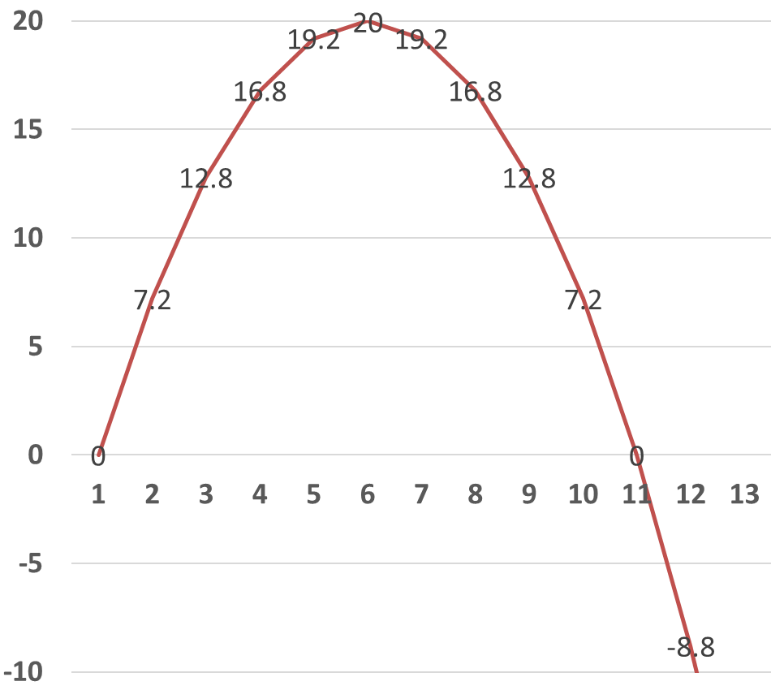
First, how do we optimize a function?
Find X that maximize: Y = 8X-.8X²

Slide 78
Y is maximized when dY/dX=0
Y = 8X-0.8X²
dY/dX = 8 – 0.8*2*X = 8-1.6X
Set dY/dX to 0:
8-1.6X=0 X=5
Find X that maximize: Y = 8X-.8X²

Slide 79
How many businesses should be on the highway?
Let’s break this down:
How does business affect travel time?
  cars = 130+290*ln(business)
  traveltime = 14.7 + 0.03*cars
  So: traveltime = 14.7 + 0.03*(130+290*ln(business) )
  Simplifying: t= 18.6+8.7ln(b)

Slide 80
How many businesses should be on the highway?
Let’s break this down:
How does business affect travel time?
  t= 18.6+8.7ln(b)
Suppose his public opinion expert says:
complaints = travel time,
praise = # of business²/2
So: praise –complaints = b²/2 – t
b²/2 – (18.6+8.7ln(b))
Take the derivative and set it to 0: b-8.7/b = 0
b=8.7/b b²=8.7 b = 3-ish

Slide 81
Imagine you are an advisor to the mayor of Pittsburgh
Should I approve 10 new businesses on a strip of a crowded highway?
The data suggests 10 is too many, Mr. Mayor. Let me walk you through my reasoning.
Mayor Peduto, GSPIA’11
YOU

Slide 82
Exercise 2
Break.
BEFORE LEAVING FOR LUNCH, PACK UP. WE WILL FORM TEAMS AND YOU WILL SIT WITH YOUR NEW TEAMMATE AFTER LUNCH.

Slide 83

On to the Race!
Analytics
V
Show Race Packet Materials.
Tomorrow: you will absolutely need your computer.
You will be coding and thinking and racing from room to room, so make sure you are comfortable.
There will be 10 clues. Solving each clue in three tries or less will earn your team 1 point. The team with the highest number of points wins the race. Ties are broken by how quickly you complete the race.
There will be Roadblocks. In Roadblocks each person in the team must solve a puzzle individually. The point will only be given if both team members successfully solve their puzzle.

Slide 84
Ok that’s enough excitement…
Any questions about Exercise 2?
Let’s dive into STATA now!

Slide 85
Schedule and people you will meet today
9:30-10:50 Intro, Lecture 1: Linear functions, Exercise 1
10:50-11:10 Meet your quant professors
11:10-11:20 Break
11:20-12:00 Lecture 2: Nonlinear functions and derivatives, Exercise 2
12:00-1:00 Lunch Break
1:00-1:15pm Amazing Analytics Race teams (TAs)
1:15-2:45 Lecture 3: Intro to Stats, Exercise 3
2:45-3:00pm Break
3:00pm-3:30pm Team exercise and alum Alex Heit

Slide 86
Writing and saving commands in STATA
In your classes (and in your job in the future) you will want more control over what you did to the data and replicability.
This is so you can remember what you did and that others can replicate your results.
This is harder to do with the menu bar.
  Go to Window, Do File Editor, and choose New Do-file Editor.
  This will open a new .do file.
  Write your commands in it.
  Highlight one of the commands and click the “Execute (do)” icon. It should run the command. You can also copy and paste directly to the command window.
  Save this file as MathCamp.do
  Continue adding commands into this file.

Slide 87
Loading and exploring
Clearing memory: clear
Loading .csv file: cars.csv
See all variables: sum
String variables (highway) vs numeric variables
Tab highway
Variable | Obs Mean Std. Dev. Min Max
-------------+---------------------------------------------------------
cars | 1,674 385.3883 232.479 0 1230
traveltime | 1,674 26.71808 8.605933 11.16805 61.63294
highway | 0
ID | 1,674 8.378136 4.848058 0 17
.

Slide 88
Relationship between variables
Pwcorr (correlation)
Reg traveltime cars
Scatter traveltime cars

Slide 89
Sorting and Viewing Data
Tab (tabulate types)
Tab then use that as new data to sort
Moving things in and out of STATA to Excel
gsort
Sort in both order
Ascending: gsort cars
Descending: gsort -cars
Sort
Only sort in ascending order
List
.
gsort cars
. list in 1/5
+----------------------------------+
v1 cars travel~e highway
----------------------------------
1. 1153 0 18.31223 Roscoe
2. 1532 0 15.03788 Roscoe
3. 1321 0 15.07491 Roscoe
4. 170 0 18.04261 Robb
5. 822 0 12.8783 Jemison
+----------------------------------+
. list in -5/L
+----------------------------------+
v1 cars travel~e highway
----------------------------------
1670. 220 1170 57.35289 Robb
1671. 253 1190 45.25637 Robb
1672. 554 1210 55.85953 Clarion
1673. 1390 1220 54.14872 Roscoe
1674. 59 1230 47.82588 Roscoe
+----------------------------------+

Slide 90
Conditional statements and working with strings
(if, and (&), or (|), ==, != )
sum traveltime if cars < 100
mean traveltime if cars > 150 & cars < 200
reg traveltime cars if highway !=“SqHill”
sum traveltime if highway ==“SqHill” | highway == “Clarion”
list traveltime if highway ==“SqHill” & cars > 400
Tab + multiple logical expression

Slide 91
Generating new variables
gen: simple transformations of other variables
  gen travelsq = traveltime^2
What if you mess up making a variable and want to recreate it? Eg. You want travelsq to be ½*traveltime^2
drop travelsq
  gen travelsq = (1/2)* traveltime^2
  Can combine gen with logical statements :
  gen toocrowded = (cars>400)
  Using your new variable:
  reg traveltime cars if toocrowded
  reg traveltime cars if !toocrowded
  reg traveltime toocrowded

Slide 92
Graphing
Comparing two subgroups:
twoway (scatter traveltime cars if toocrowded) (scatter traveltime cars if !toocrowded)
twoway (scatter traveltime cars if highway==“Roscoe”) (scatter traveltime cars if highway==“Robb”)
Comparing two version of traveltime:
twoway (scatter traveltime cars) (scatter travelsq cars)
How to save your graphs?
File– Save As – (I usually do .pdf)
Or: Win users: right click and click Copy and then paste into your word doc.

Slide 93
Review Exercise 3
Any questions?
Ok but what I really want to know is .. How can I win the Amazing Analytics Race?

Slide 94
How to increase your winning probability
Review all the material tonight with your teammate and decide on how you want to handle roadblocks and other scenarios. The math will be simple but will require creative applications.
Stata commands: You MUST get familiar with all the commands we did today.
When getting your answers checked you can send just one person so one of you can continue working.
Tomorrow: you can setup starting from 12:30pm. We will distribute materials for the race at 1pm
On to work with your teammate! (Group exercise)

Slide 95

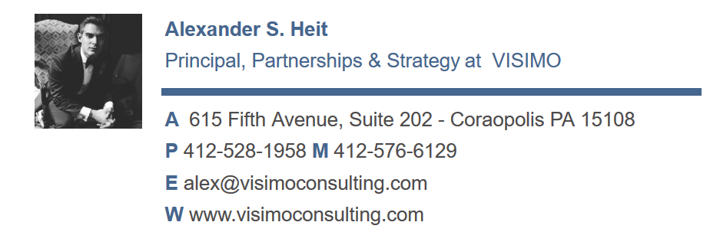
Alumni analytics career talk

Slide 96

Training done!
But you can stay to work on the group exercise and talk to us until 4pm.

